Slide 1



Naming Ionic
and
Molecular Compounds

Slide 2
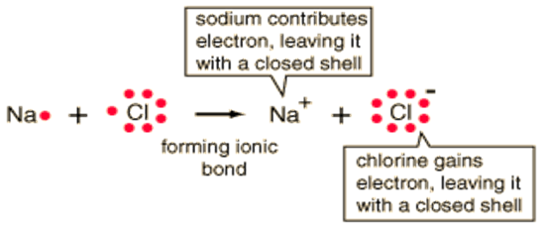
Ionic Compounds
A binary ionic compound is formed between one metal ion and one non-metal ion.
The metal donates valence electrons to become a positive ion.
The non-metal accepts these electrons into its outer energy level to become a negative ion.
For example:
The positively charged sodium ion is attracted to the negatively charged chloride ion. This attraction is called an ionic bond.

Slide 3
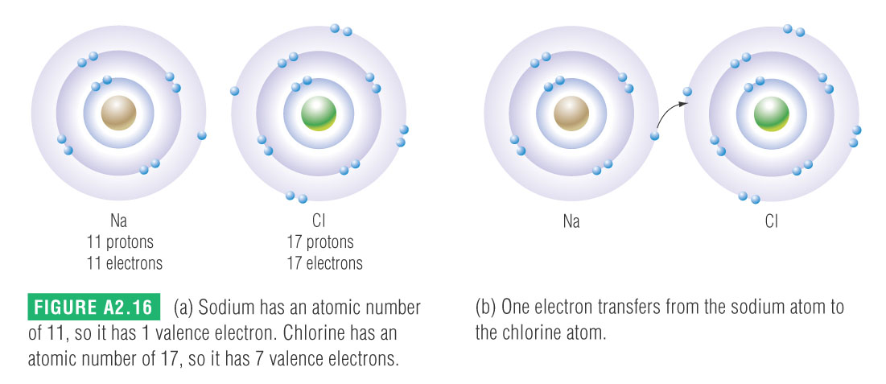
(text page 41)

Slide 4
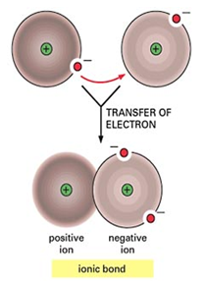

Slide 5
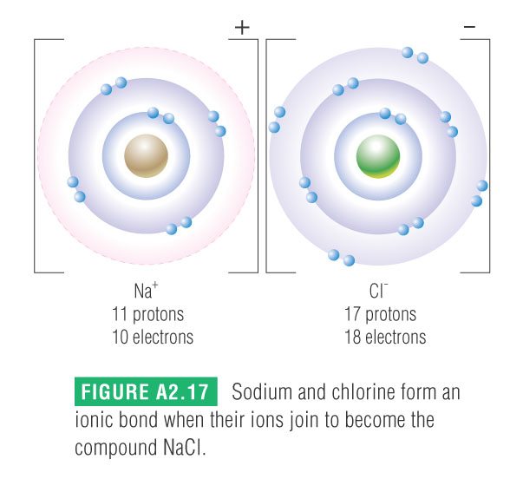

Slide 6
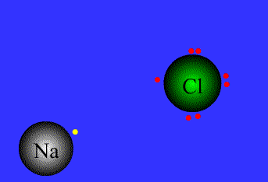

Slide 7

Ionic Bonds: One Big Greedy Thief Dog!

Slide 8
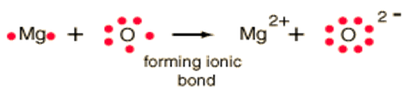

Magnesium has two valence electrons and oxygen has six.
Magnesium has donated two electrons to one oxide ion.
Calcium has two valence electrons and chlorine has seven.
Calcium has donated two electrons to two chloride ions (they accept one each).

Slide 9
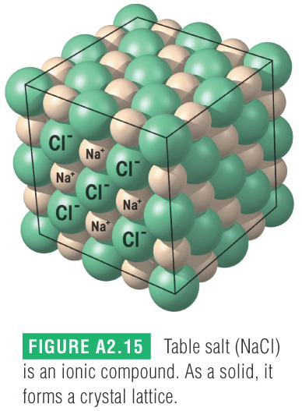
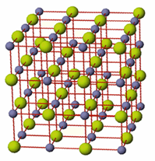
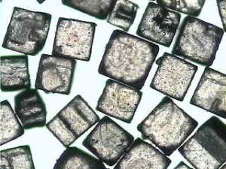
Ionic compounds do not form individual molecules, but exist as a crystal lattice structure.
This is a regular three-dimensional pattern of alternating positive and negative ions producing an electrically neutral compound.
This is very stable arrangement, so all ionic compounds are solid at room temperature.
For sodium chloride, there is one sodium ion for every chloride ion (they are in a 1:1 ratio).

Slide 10
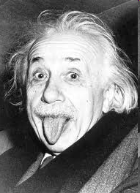
Naming Ionic Compounds
The chemical formula of an ionic compound represents the lowest whole number ratio of the ions in the crystal and it is called a formula unit.
Write the name of the metal (positive) ion first.
2) Write the name of the non-metal (negative) ion last and change the ending to “-ide.”
The name of an ionic compound does not use prefixes to show the number of ions present.
examples:
Einstein sez:
KBr(s)
potassium bromide
MgCl₂(s)
magnesium chloride
Na₂S(s)
sodium sulfide

Slide 11
Formulas For Ionic Compounds - The Criss-Cross Method
When writing formulas of binary ionic compounds, the symbols for the elements are written in the same order as they appear in the name. Subscript numbers are used to indicate the ratio of the ions in the compound.
The charges on the ions must balance in the chemical formula, since ionic compounds are electrically neutral.
Identify the ions and their charges.
2) Determine the ratio of charges needed to balance.
3) The charge on the metal ion crosses to become the subscript on the non-metal ion. Do not include the ( + ) sign.
4) The charge on the non-metal ion crosses to become the subscript on the metal ion. Do not include the ( – ) sign.
5) Reduce the ratio of subscripts in the formula.

Slide 12
examples:
1) aluminum fluoride
2) silver sulfide
3) potassium iodide
4) zinc nitride

Slide 13
Writing a Formula
Write the formula for the ionic compound that will form between Ba²⁺ and Cl⁻.
Solution:
1. Balance charge with + and – ions
2. Write the positive ion of metal first, and the
negative ion Ba²⁺ Cl⁻ Cl⁻
3. Write the number of ions needed as
subscripts BaCl₂

Slide 14
Solution
A. Sodium sulfide Na⁺, S²⁻
Na₂S
B. Aluminium chloride Al³⁺, Cl⁻
AlCl₃
C. Magnesium nitride Mg²⁺, N³⁻
Mg₃N₂

Slide 15
Learning Check
Complete the names of the following binary compounds:
Na₃N sodium ________________
KBr potassium ________________
Al₂O₃ aluminum ________________
MgS magnesium ________________

Slide 16
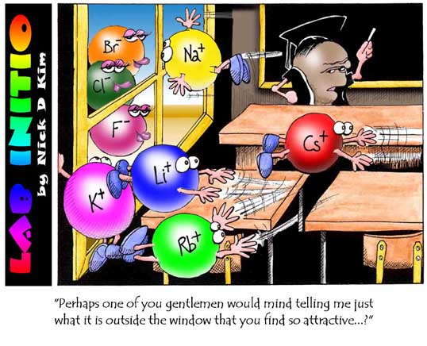

Slide 17
Multi - Valent Ions (p. 46-50)
When the metal in an ionic compound is multi-valent there are 2 methods:
Classical (Latin) or Stock (IUPAC)
Latin is older (not useful for some compounds)
As before, the name ends in “-ide” & + is first
The metal is named with it’s Latin or English root and ends in -ic or –ous to denote valence
E.g. Cu¹⁺ is cuprous, E.g. Cu²⁺ is cupric
Lower = ous, Higher = ic
Be able to recognize these but you are not responsible to work with them.

Slide 18
Classical System

Slide 19
Determining the Charge on a Multivalent Cation – Au₂S₃
determine the charge on the anion
  Au₂S₃ - the anion is S, since it is in Group 6A, its charge is -2
determine the total negative charge
  since there are 3 S in the formula, the total negative charge is -6
determine the total positive charge
  since the total negative charge is -6, the total positive charge is +6
divide by the number of cations
  since there are 2 Au in the formula & the total positive charge is +6, each Au has a +3 charge

Slide 20
Names of Variable Ions
Use a roman number after the name of a metal that forms two or more ions
Transition metals and
the metals in groups 4A and 5A
FeCl₃ (Fe³⁺) iron (III) chloride
CuCl (Cu⁺ ) copper (I) chloride
SnF₄ (Sn⁴⁺) tin (IV) fluoride
PbCl₂ (Pb²⁺) lead (II) chloride
Fe₂S₃ (Fe³⁺) iron (III) sulfide

Slide 21
Learning Check
Complete the names of the following binary compounds with variable metal ions:
FeBr₂ iron (_____) bromide
Cu₂O copper (_____) oxide
SnCl₄ ___(_____ ) ______________
Fe₂O₃ ________________________
CuS ________________________

Slide 22
Solution
Complete the names of the following binary compounds with variable metal ions:
FeBr₂ iron ( II ) bromide
Cu₂O copper ( I ) oxide
SnCl₄ tin (IV) chloride
Fe₂O₃ iron (III) oxide
CuS copper (II) sulfide

Slide 23
Learning Check
Name the following compounds:
A. CaO
1) calcium oxide 2) calcium(I) oxide
3) calcium (II) oxide
B. SnCl₄
1) tin tetrachloride 2) tin(II) chloride
3) tin(IV) chloride
C. Co₂O₃
1) cobalt oxide 2) cobalt (III) oxide
3) cobalt trioxide

Slide 24
Solution
Name the following compounds:
A. CaO 1) calcium oxide
B. SnCl₄ 3) tin(IV) chloride
C. Co₂O₃ 2) cobalt (III) oxide

Slide 25
Compounds With Multivalent Elements
Ionic compounds with multivalent elements must have Roman numerals after the name of the positive (metal) ion to indicate the charge on that ion.
Compound Name | Formula
iron(III) chloride
lead(IV) oxide
nickel(III) sulfide
copper(II) fluoride
chromium(III) sulfide
Use roman numerals ONLY when the metal element is multivalent.

Slide 27

Polyatomic Ions
Polyatomic ions consist of a group of atoms combined together that exist as a single unit with an overall electric charge.
Most polyatomic ions have a negative charge, which means they behave as non-metals. This means that they are always written last in the formula.
The one exception: ammonium ion
Don sez:
When writing the formula for compounds containing more than one of a polyatomic ion, the symbol for the ion must be written in brackets. Beauty eh.

Slide 28
In a single atom (monatomic), charge results
from having either more electrons
or less electrons than protons.
+
+
More electrons than protons
= negative charge (anions)
+
+
+
Less electrons than protons
= positive charge (cations)
+
+
+
+
+

Slide 29
2+
Mg
Example: The magnesium ion has
two
less electrons than protons

Slide 30
1-
O
N
O
O

Slide 31
1-
2+
1-
O
O
N
N
O
O
Mg
O
O
Mg(NO₃)₂
the charges are balanced
2+
2-

Slide 32
Naming Ionic with Polyatomic Ion
Na₂SO₄
1. Identify the ions
Name the cation
Name the anion
Write the name of the cation followed by the name of the anion

Slide 33
Some Common Polyatomic Ions
Name | Formula
acetate | C₂H₃O₂–
carbonate | CO₃^{2–}
hydrogen carbonate | HCO₃–
hydroxide | OH–
nitrate | NO₃–
nitrite | NO₂–
chromate | CrO₄^{2–}
dichromate | Cr₂O₇^{2–}
ammonium | NH₄⁺
Name | Formula
hypochlorite | ClO–
chlorite | ClO₂–
chlorate | ClO₃–
perchlorate | ClO₄–
sulfate | SO₄^{2–}
sulfite | SO₃^{2–}
hydrogensulfate (aka bisulfate) | HSO₄–
hydrogensulfite (aka bisulfite) | HSO₃–

Slide 34
examples:
Compound Name | Formula
barium hydroxide
iron (III) carbonate
copper (I) permanganate
gold (III) nitrate
ammonium phosphate
potassium dichromate

Slide 35
Patterns for Polyatomic Ions
elements in the same column form similar polyatomic ions
  same number of O’s and same charge
  ClO₃⁻ = chlorate ∴ BrO₃⁻ = bromate
if the polyatomic ion starts with H, the name adds hydrogen- prefix before name and add 1 to the charge
  CO₃²⁻ = carbonate ∴ HCO₃¹⁻ = hydrogen carbonate

Slide 36
Patterns for Polyatomic Ions
-ate ion
  chlorate = ClO₃¹⁻
-ate ion + 1 O ⇒ same charge, per- prefix
  perchlorate = ClO₄¹⁻
-ate ion – 1 O ⇒ same charge, -ite suffix
  chlorite = ClO₂¹⁻
-ate ion – 2 O ⇒ same charge, hypo- prefix, -ite suffix
  hypochlorite = ClO¹⁻

Slide 37
Common Mistakes
Be careful:
sulfide = S²⁻ sulfate = SO₄²⁻
sulfite = SO₃²⁻
sulfur tetraoxide = SO₄ sulfur trioxide = SO₃
nitride = N³⁻ nitrate = NO₃²⁻
nitrite = NO₂⁻
nitrogen dioxide = NO₂ nitrogen trioxide = NO₃
ammonia = NH₃ ammonium = NH₄⁺

Slide 38
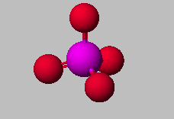

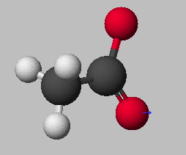
Nomenclature
PO₄³⁻
phosphate ion
HC₂H₃O₂
Acetic Acid
C₂H₃O₂⁻
acetate ion

Slide 39
examples:
Compound Name | Formula
barium hydroxide
iron (III) carbonate
copper (I) permanganate
gold (III) nitrate
ammonium phosphate
potassium dichromate

Slide 40
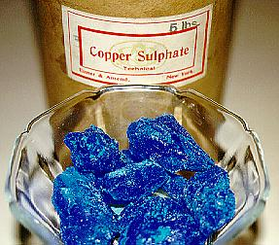
Hydrated Ionic Compounds
Hydrated ionic compounds
are those ionic compounds which contain water molecules inside their crystal lattice The water is not chemically bonded to the crystal and may be driven off by heating the hydrated compound.
Eg.) Copper(II) sulfate pentahydrate
To write the chemical formula; write the ionic compound then write a "dot" followed by "H₂O"
the number corresponding to the prefix attached to the "hydrate" from the "word" equation.
Example(s):
ZnCl₂ • 6H₂O is
Ba(OH)₂ • 8H₂O is
Zinc chloride hexahydrate
Barium hydroxide octahydrate

Slide 41
Do Now
Take out your homework for a homework check
Name the following compounds:
  MgCl₂
  KBr
  Li₂O
  Ti₂O₃
  CuPO₄

Slide 42
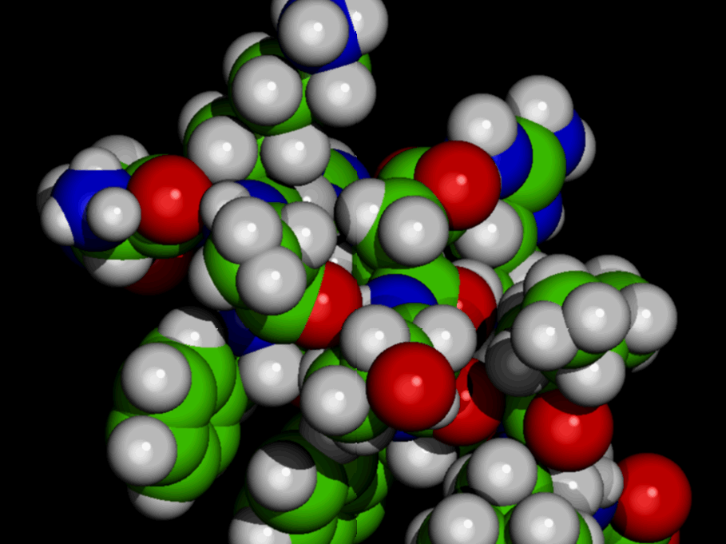
Molecular
Compounds

Slide 43
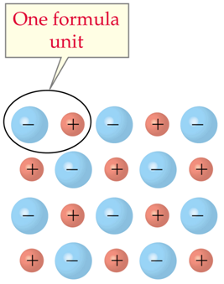
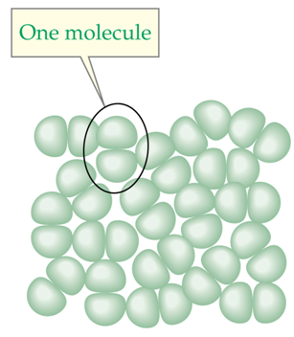
Molecules
Remember, for ionic compounds, a formula unit is a ratio of the number of ions in a crystal lattice.
Ionic compounds do not form independent units.
ionic compound
A molecule is two or more non-metal atoms bonded together. Each molecule is independent of the next, and is not part of a lattice.
molecular compound

Slide 44
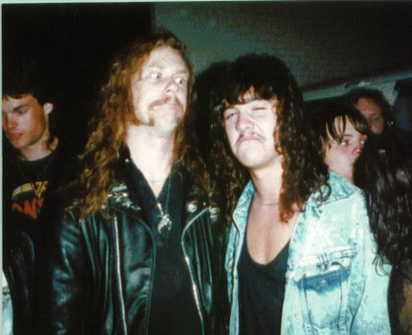
Binary molecular compounds are formed between two non-metal elements.
No metals??? No WAY!!
Yeah, dude. Metal rules.

Slide 45



Covalent Bonds
Remember that non-metals need to gain electrons to have a full outer shell.
When non-metal atoms combine, the only way this can be achieved is if they share their outer electrons.
a pair of shared electrons
two chlorine atoms
one chlorine molecule
Since electrons are being shared (always in pairs), there is a strong force of attraction between the two atoms. This force is a covalent bond.

Slide 46
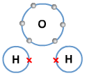

two pairs of shared electrons
an oxygen atom and two hydrogen atoms
a water molecule

Slide 47
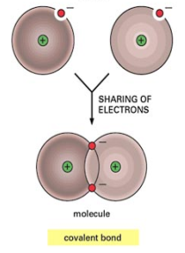

Slide 48
Molecular Elements
The vast majority of elements exist in nature as single atoms. These are called monoatomic.
There are a few diatomic elements (exist as pairs of atoms), which you must memorize.
I₂(g) Br₂(g) Cl₂(g) F₂(g) O₂(g) N₂(g) H₂(g)
“I Bring Clay For Our New House.”
There are two polyatomic elements which also must be memorized.
P₄(s) S₈(s)
“And four Paving stones for eight Steps.”

Slide 49
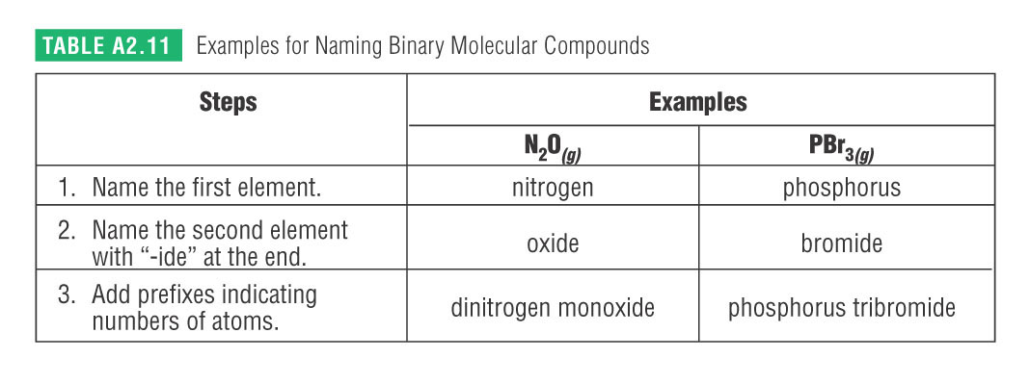
Do Now: Copy the following
Naming Binary Molecular Compounds

Slide 50
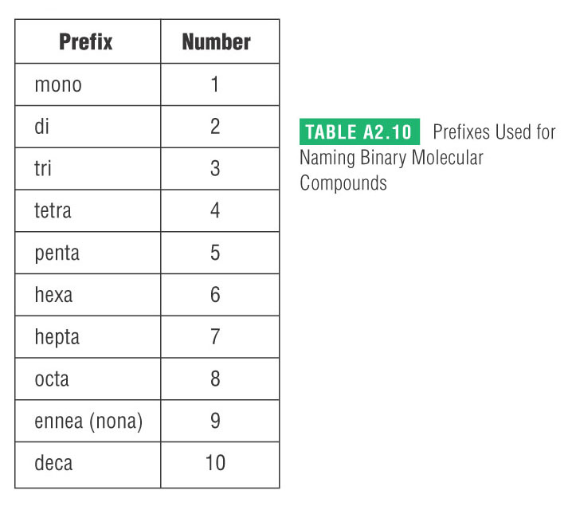
Naming Binary Molecular Compounds
The prefix “mono-” is not used when the first element is only one atom.
This does not apply to the second element.

Slide 51
examples:
Name | Formula
carbon dioxide
dinitrogen monoxide
phosphorus trichloride
oxygen difluoride
dinitrogen tetrasulfide
sulfur trioxide

Slide 52
Homework:
read pages 44 – 49
Worksheets:
  Line Master 10 - Ionic Compounds – Polyatomic Ions
  Line Master 12 - Binary Molecular Compounds

Slide 53
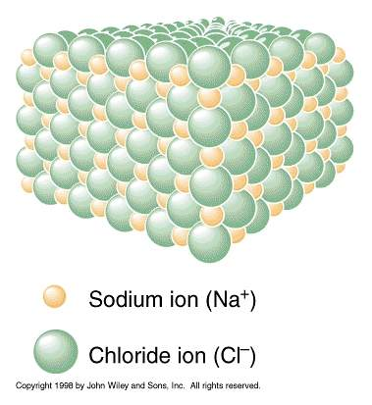

Slide 54
What are POLYATOMIC IONS?
Lets first review what a monatomic ion is
What is a group of atoms with charge?

Slide 55
In a single atom (monatomic), charge results
from having either more electrons
or less electrons than protons.
+
+
More electrons than protons
= negative charge (anions)
+
+
+
Less electrons than protons
= positive charge (cations)
+
+
+
+
+

Slide 56
Nomenclature
PO₄³⁻
phosphate ion
HC₂H₃O₂
Acetic Acid
C₂H₃O₂⁻
acetate ion

Slide 57
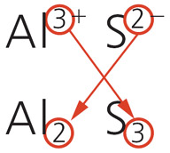
Review: Binary Ionic Compounds
Rules for naming
Names end in “–ide”. Example: sodium chloride
Metal (+ ion) comes 1st (not chorine sodide)
Use the group valence for nonmetals
Do not capitalized unless starting a sentence
Give formulae & name: Ca + I, O + Mg, Na + S
= Ca²⁺ / I¹⁻ = CaI₂ = calcium iodide
= Mg²⁺ / O²⁻ = MgO = magnesium oxide
= Na¹⁺ / S²⁻ = Na₂S = sodium sulfide

Slide 58
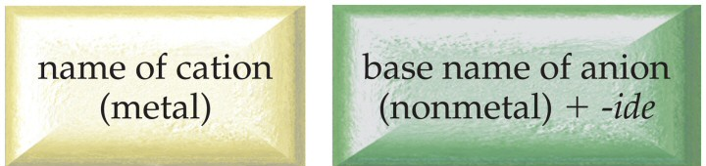
Binary Ionic Compounds
Contain Metal Cation + Nonmetal Anion
Metal listed first in formula & name
name metal cation first, name nonmetal anion second
cation name is the metal name
nonmetal anion named by changing the ending on the nonmetal name to -ide

Slide 59
Learning Check
Write the correct formula for the compounds containing the following ions:
A. Sodium sulfide
1) NaS 2) Na₂S 3) NaS₂
B. Aluminium chloride
1) AlCl₃ 2) AlCl 3) Al₃Cl
C. Magnesium nitride
1) MgN 2) Mg₂N₃ 3) Mg₃N₂

Slide 60
Solution
Complete the names of the following binary compounds:
Na₃N sodium nitride
KBr potassium bromide
Al₂O₃ aluminum oxide
MgS magnesium sulfide

