Slide 1
Science 10 Focus on Plants
9.1
Specialized and Organized

Slide 2
Plant Cell specialization
Leaves contain many types of specialized cells that function for one main reason…
PHOTOSYNTHESIS: a biochemical process powered by light energy in which carbon dioxide from the air and water from the soil are combined to make glucose and oxygen.
Notes:
Insert LSOF 04.013, 04.015, 04.003, 04.004, 04.016, 04.017

Slide 3
Leaf Structure

Slide 4
EPIDERMAL CELLS

Slide 5
Epidermal Cells
Upper and lower epidermal cells are tightly interlocked to prevent physical damage or penetration by pathogens (disease)
1 layer thick!

Slide 6
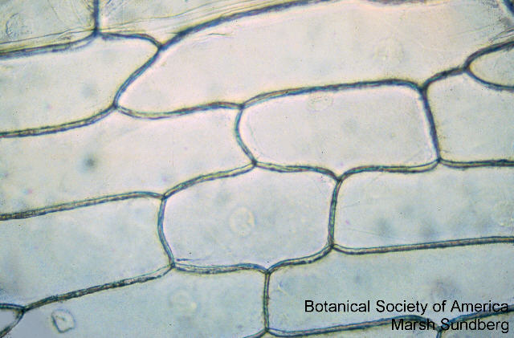
Epidermal Cells
Waxy cuticle acts as water barrier to conserve water

Slide 7
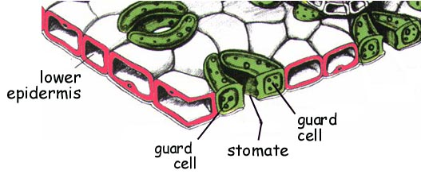
Stomata and Guard Cells

Slide 8
Stomata and Guard Cells
Guard cells on lower epidermis control opening and closing of stomata
allows gas exchange between external and interior photosynthetic cells, also conserve water
Stomata clip

Slide 9
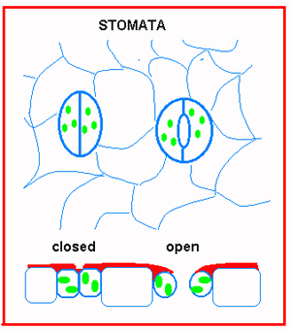
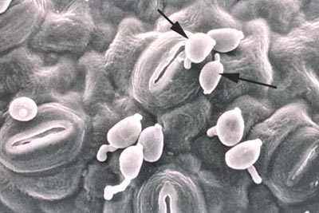
Stomata and Guard Cells

Slide 10
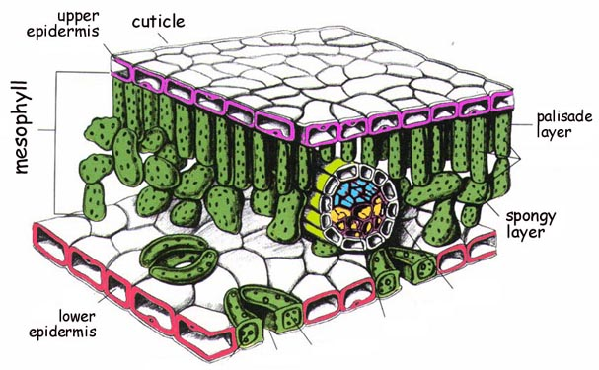
Vascular Tissue

Slide 11
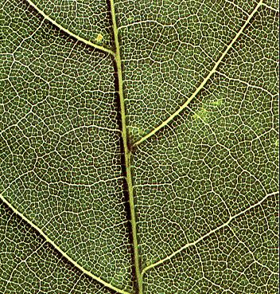
Vascular Tissue
Forms a series of tubes that transport fluids
Look like leaf veins
2 kinds…

Slide 12
Vascular Tissues
XYLEM – carries water and mineral from roots to leaves
PHLOEM – carries sugars produced by leaves to other parts of the plant
Arranged together in a vascular bundle

Slide 13
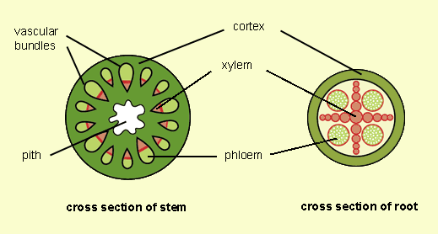

Slide 14
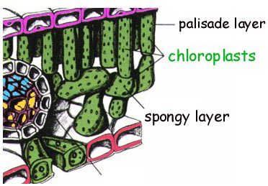
Chloroplasts

Slide 15
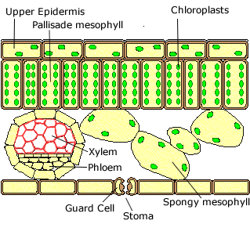
Palisade Tissue – Photosynthesis
Long narrow columns packed closely together

Slide 16
Layers of Tissue in Leaf Cross Section
Epidermal
Palisade Layer
Spongy Layer

Slide 17
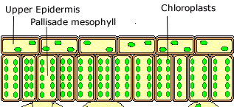
Palisade tissue
Efficient for Photosynthesis because:
Close to upper layer for max sun exposure
Packed FULL of chloroplasts
Cytoplasm “streams” in circles so chloroplasts take turns near the top
Most photosynthesis
occurs here
Streaming clip

Slide 18
Spongy Tissue
Very few chloroplasts
Round with many spaces between them
Gases collect here before being expelled from stomata

Slide 19
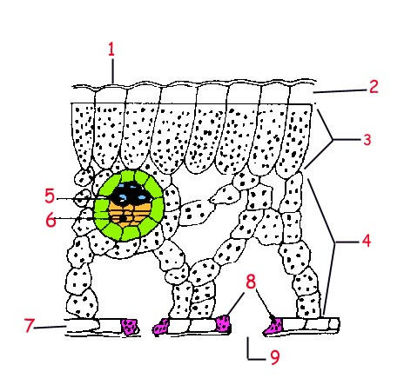
Label the Following Diagram
1 – Waxy Cuticle
2 – Upper Epidermis
3 – Palisade Layer
4 – Spongy Layer
5 – Xylem
6 – Phloem
7 – Lower Epidermis
8 – Guard Cells
9 - Stomata

Slide 20
Photosynthesis tissue

Slide 21
Xylem and Phloem Continuation

Slide 22
Cell, Tissue, Organ, System
Compared to single-celled organisms, multicellular organisms have 3 primary advantages:
A larger size
A variety of specialized cells
An ability to thrive in a broader range of environments

Slide 23
With more complexity, however, more organization is needed. There are successive levels of organization in multicellular organism. Here is one example.

Slide 24
Cells: the most basic unit of organization in organisms.
Ex.
Tissues: a cluster of similar cells that share the same structure and function.
Ex.
Organ: a combination of various types of tissue that work together to perform a specific function.
Ex.
System: a combination of organs and tissues that perform a shared complex function.
Ex.

