Slide 1
Surface Area to Volume Ratio
and Levels of Organization

Slide 2
Cells are restricted to a size that assures a surface area to volume ratio that provides a sufficient membrane area to meet the transport needs of a cell.
Huge insects… possible?

Slide 3
As a cell increases in size, its volume grows faster than does its surface area (membrane).
When the cell membrane can no longer provide the cell with material for life processes or rid the cell of wastes – the cell divides.

Slide 4
Levels of Organization
Unicellular Organisms
Multicellular Organisms

Slide 5
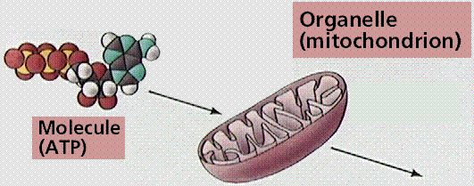
Molecule → Organelle

Slide 6
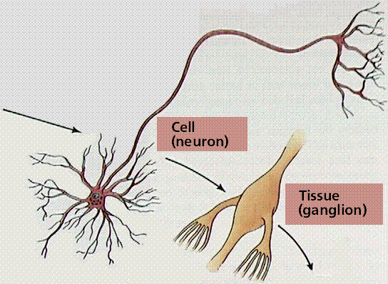
Cell → Tissue

Slide 7
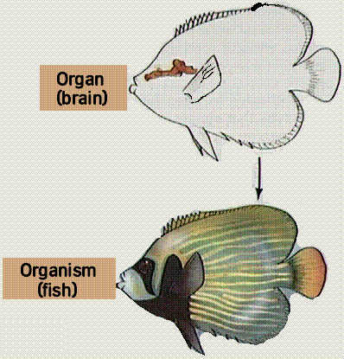
Organ → Organism

Slide 8
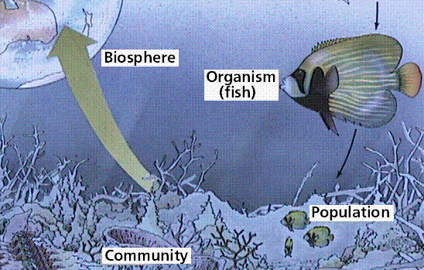
Organism → Biosphere

Slide 9
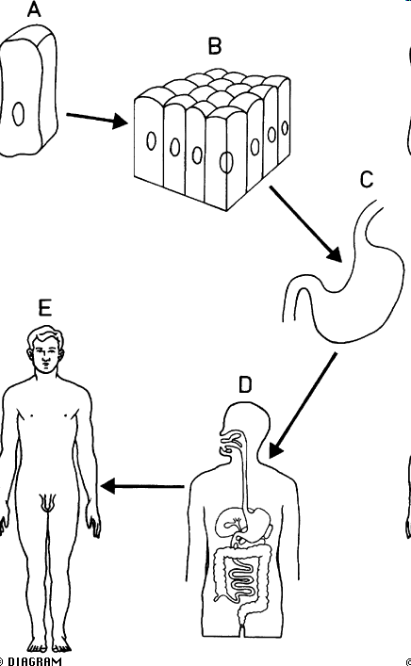
Levels of Organization
Cell: Basic unit of structure and function
Tissue: A group of cells of similar cells that work together to carry out a similar function
Cell
Tissue

Slide 10
Levels of Organization
Organ: A group of tissues that work together to carry out a specific function
Organ system: A group of organs that work together to carry out a function
Organism
Organ
Organ System

Slide 11
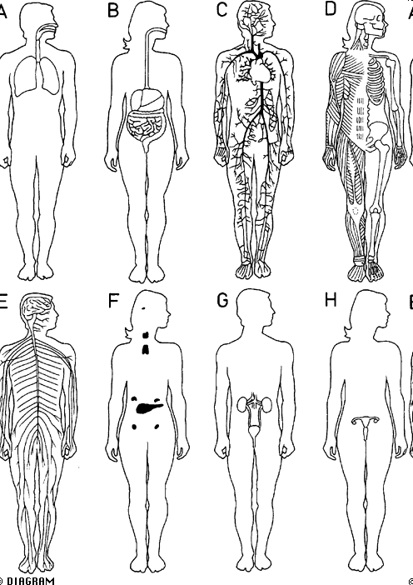
Organ Systems
Respiratory
Circulation
Digestive
Skeletal/Muscular
Reproduction
Endocrine
Nervous
Excretion

Slide 12
Explained mathematically, as surface area is squared, the volume is cubed.
Example:
1 cm
SA = 6 (sides) x 1cm x 1cm = 6 cm² = 6:1
Vol = 1 cm x 1 cm x 1 cm =1 cm³
2 cm
SA = 6 (sides) x 2cm x 2cm 24 cm² = 3:1
Vol = 2 cm x 2 cm x 2 cm 8 cm³
2 cm
What would be the surface area to volume of a cube with all sides- 5cm?

Slide 13
What would be the surface area to volume ratio of a cube with all sides 5-cm?

