Slide 1
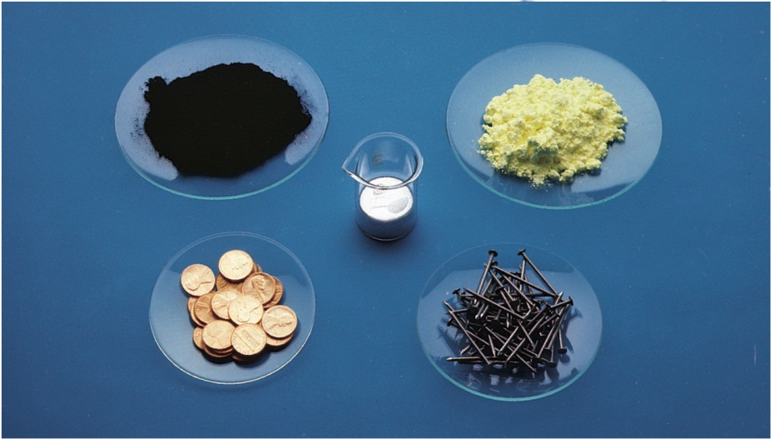
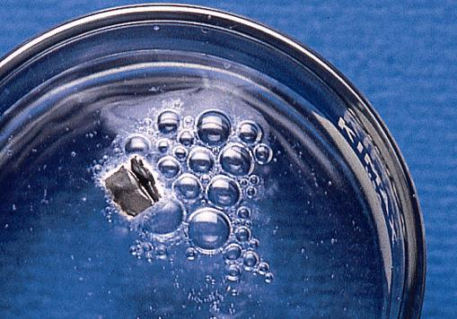
Mass Relationships in Chemical Reactions
Copyright © The McGraw-Hill Companies, Inc. Permission required for reproduction or display.

Slide 2
Names associated with an amount
Dozen = 12
Pair = 2
Can you think of any more?????

Slide 3
The Mole…..
The mole (mol) is the amount of a substance that
contains as many elementary entities as there
are atoms in exactly 12.00 grams of ¹²C
1 mol = N_{A} = 6.0221367 x 10²³
Avogadro’s number (N_{A})

Slide 4
eggs
shoes
Molar mass is the mass of 1 mole of in grams
marbles
atoms
1 mole ¹²C atoms = 6.022 x 10²³ atoms = 12.00 g
1 ¹²C atom = 12.00 amu
1 mole ¹²C atoms = 12.00 g ¹²C
1 mole lithium atoms = 6.941 g of Li
For any element
atomic mass (amu) = molar mass (grams)
3.2

Slide 5
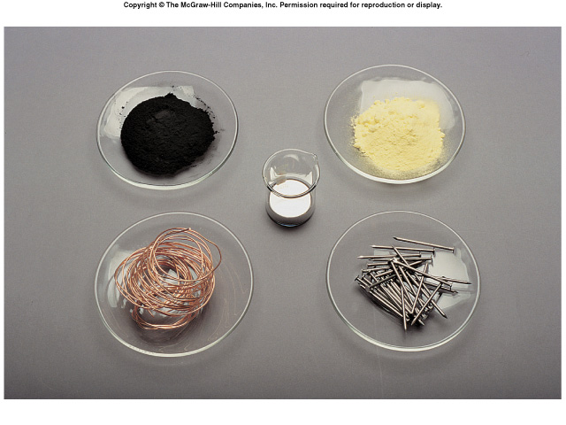
What is the mass of one mole of:
C
S
Hg
Cu
Fe
3.2

Slide 6
How many atoms are in
0.551 g of potassium (K) ?
1 mol K = 39.10 g K
1 mol K = 6.022 x 10²³ atoms K
1 mol K
6.022 x 10²³ atoms K
0.551 g K
x
x
=
39.10 g K
1 mol K
8.49 x 10²¹ atoms K
Let’s try a few more…………….
3.2

Slide 7
Molar Mass
The molar mass of a compound is found by adding
Together the molar masses of all of its elements, taking
Into account the number of moles of each element present.
Let’s try using the mole and molar mass………………..

Slide 8
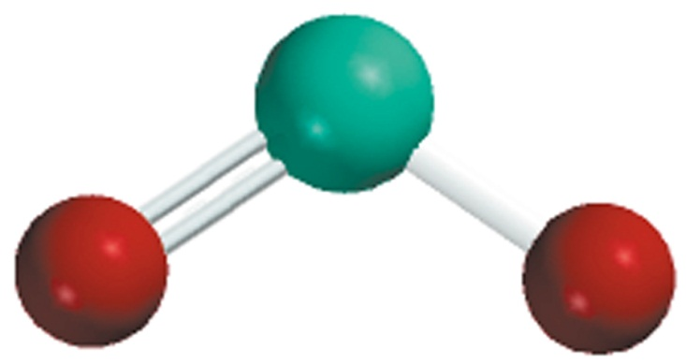
Molecular mass (or molecular weight) is the sum of
the atomic masses (in amu) in a molecule.
1S
32.07 amu
2O
+ 2 x 16.00 amu
SO₂
SO₂
64.07 amu
For any molecule
molecular mass (amu) = molar mass (grams)
1 molecule SO₂ = 64.07 amu
1 mole SO₂ = 64.07 g SO₂
Let’s try some more……………..

Slide 9
How many H atoms are in 72.5 g of C₃H₈O ?
1 mol C₃H₈O = (3 x 12) + (8 x 1) + 16 = 60 g C₃H₈O
1 mol C₃H₈O molecules = 8 mol H atoms
1 mol H = 6.022 x 10²³ atoms H
1 mol C₃H₈O
8 mol H atoms
6.022 x 10²³ H atoms
72.5 g C₃H₈O
x
x
x
=
60 g C₃H₈O
1 mol C₃H₈O
1 mol H atoms
5.82 x 10²⁴ atoms H
Let’s do some more…………..

Slide 11
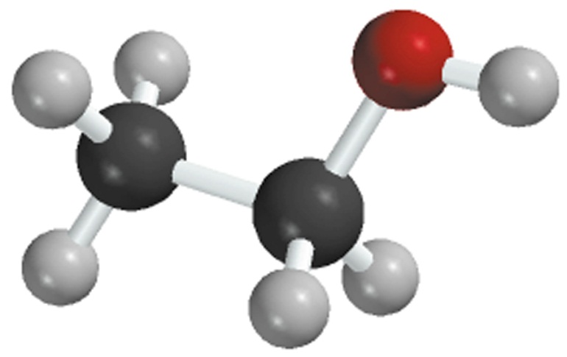
Percent composition of an element in a compound
n x molar mass of element
x 100%
molar mass of compound
n is the number of moles of the element in 1 mole of the compound
2 x (12.01 g)
%C =
x 100% = 52.14%
46.07 g
6 x (1.008 g)
%H =
x 100% = 13.13%
46.07 g
1 x (16.00 g)
%O =
x 100% = 34.73%
46.07 g
C₂H₆O
52.14% + 13.13% + 34.73% = 100.0%

Slide 12
Percent Composition
The listing of the mass of each element present in
100 g of a compound (elemental analysis)
Empirical formula: contains the smallest set of whole-
Number subscripts that match the elemental analysis
What is the chemical formula for a compound with
The following elemental analysis?
49.5% C 5.2% H 28.8%N 16.5% O

Slide 13
Combustion Analysis
In combustion analysis a hot stream of oxygen gas reacts with a
compound to form CO₂ and H₂O. The product gases are trapped,
and their masses are determined by the gain in mass of each trap.

Slide 14
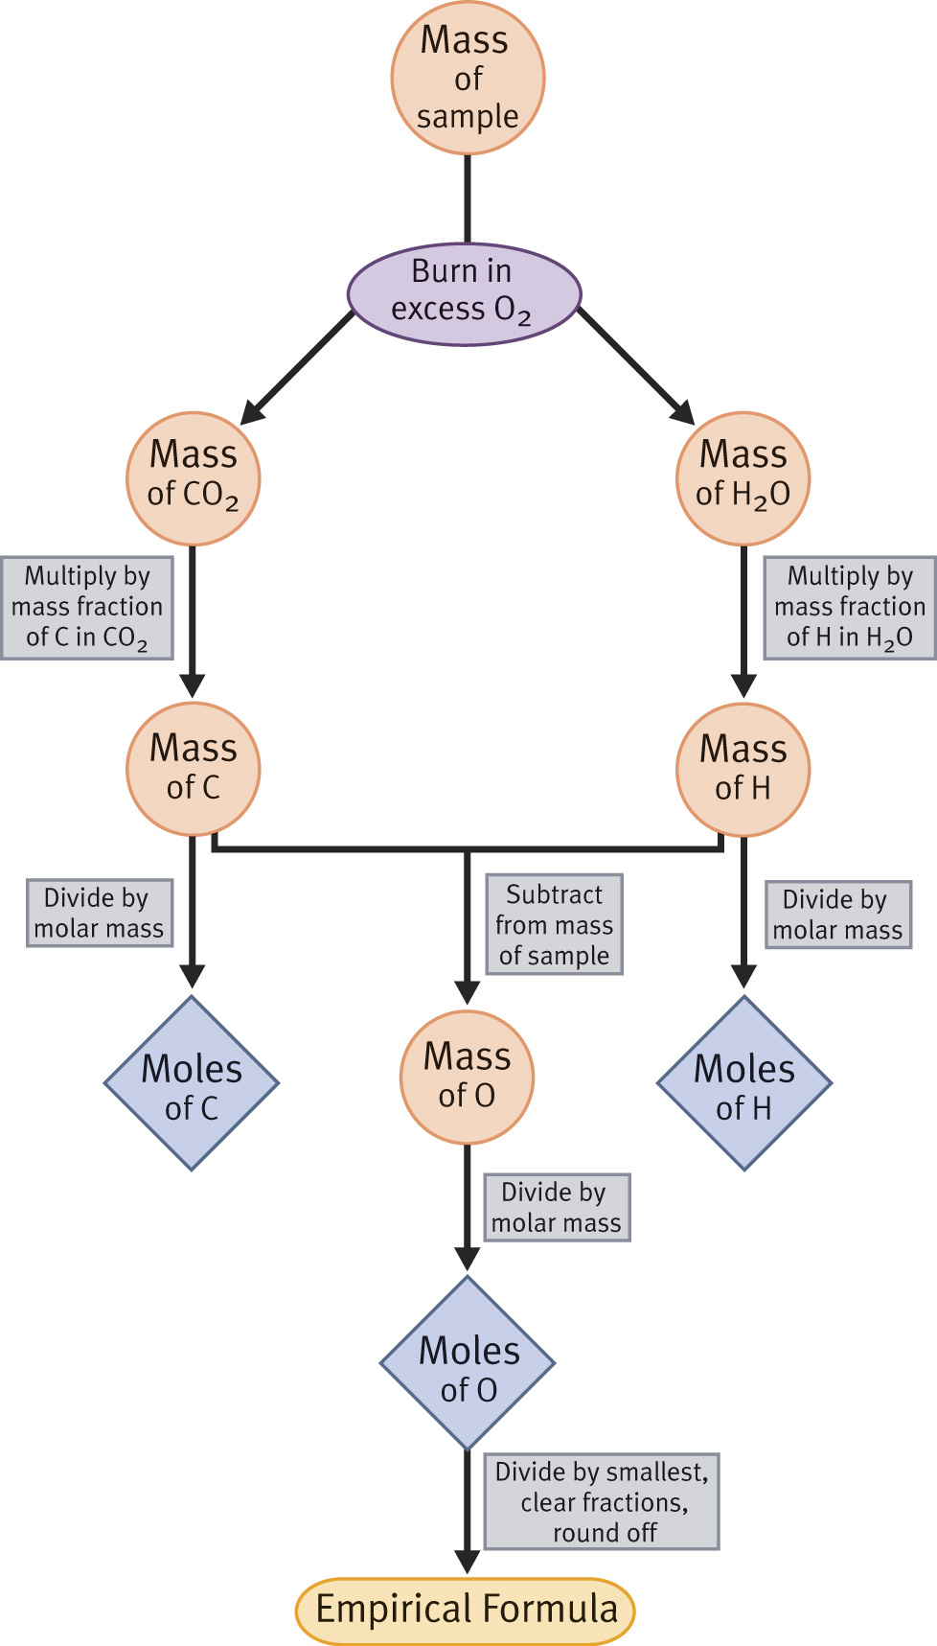
Method for
Determining the
Empirical formula
Of a compound
From combustion
Analysis

Slide 15
Combust 11.5 g ethanol
Collect 22.0 g CO₂ and 13.5 g H₂O
g CO₂
mol CO₂
mol C
g C
6.0 g C = 0.5 mol C
g H₂O
mol H₂O
mol H
g H
1.5 g H = 1.5 mol H
g of O = g of sample – (g of C + g of H)
4.0 g O = 0.25 mol O
Empirical formula C_{0.5}H_{1.5}O_{0.25}
Divide by smallest subscript (0.25)
Empirical formula C₂H₆O
3.6

Slide 16
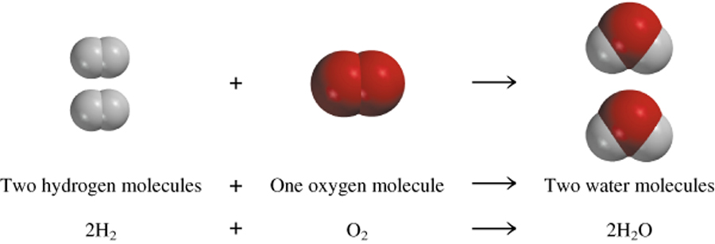
A process in which one or more substances is changed into one or more new substances is a chemical reaction
A chemical equation uses chemical symbols to show what happens during a chemical reaction
3 ways of representing the reaction of H₂ with O₂ to form H₂O
reactants
products
3.7

Slide 17
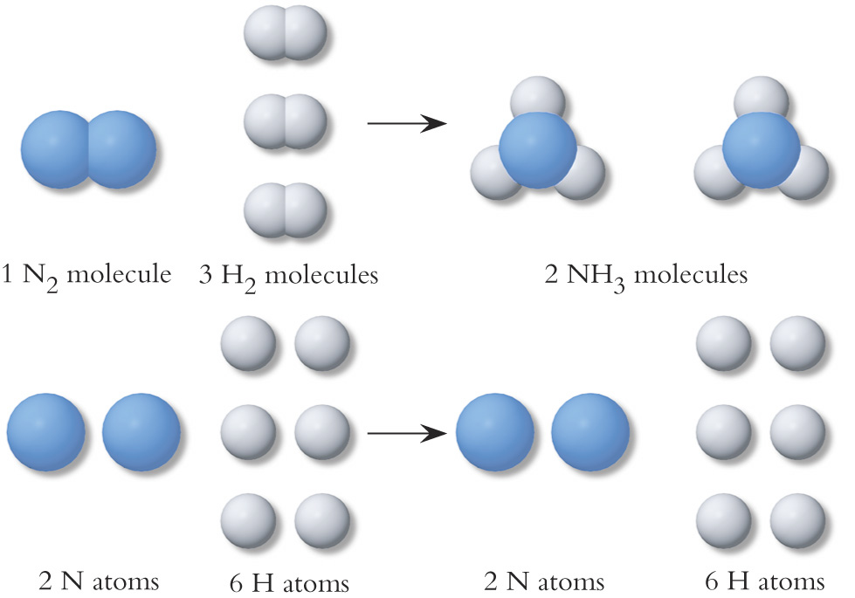

Slide 18
How to “Read” Chemical Equations
2 Mg + O₂ 2 MgO
2 atoms Mg + 1 molecule O₂ makes 2 formula units MgO
2 moles Mg + 1 mole O₂ makes 2 moles MgO
48.6 grams Mg + 32.0 grams O₂ makes 80.6 g MgO
IS NOT
2 grams Mg + 1 gram O₂ makes 2 g MgO
3.7

Slide 19
Balancing Equations
A chemical equation is made up of reactants on the left
And the products on the right. An arrow signifies reactants
going to products
Why?-----Atoms are conserved in chemical reactions
The equation is balanced only by adjusting the coefficients of the
formulas as necessary to get whole number coefficients.
NEVER introduce extraneous formulas
NEVER change subscripts of the formulas

Slide 20
Balancing Chemical Equations
Write the correct formula(s) for the reactants on the left side and the correct formula(s) for the product(s) on the right side of the equation.
Ethane reacts with oxygen to form carbon dioxide and water
C₂H₆ + O₂
CO₂ + H₂O
Change the numbers in front of the formulas (coefficients) to make the number of atoms of each element the same on both sides of the equation. Do not change the subscripts.
2C₂H₆
NOT
C₄H₁₂
3.7

Slide 21
Balancing Chemical Equations
Start by balancing those elements that appear in only one reactant and one product.
C₂H₆ + O₂
CO₂ + H₂O
start with C or H but not O
2 carbon
on left
1 carbon
on right
multiply CO₂ by 2
C₂H₆ + O₂
2CO₂ + H₂O
6 hydrogen
on left
2 hydrogen
on right
multiply H₂O by 3
C₂H₆ + O₂
2CO₂ + 3H₂O
3.7

Slide 22
Balancing Chemical Equations
Balance those elements that appear in two or more reactants or products.
C₂H₆ + O₂
2CO₂ + 3H₂O
multiply O₂ by 7/2
2 oxygen
on left
4 oxygen
(2x2)
+ 3 oxygen
(3x1)
= 7 oxygen
on right
remove fraction
multiply both sides by 2
C₂H₆ + 7/2O₂
2CO₂ + 3H₂O
2C₂H₆ + 7O₂
4CO₂ + 6H₂O
3.7

Slide 23
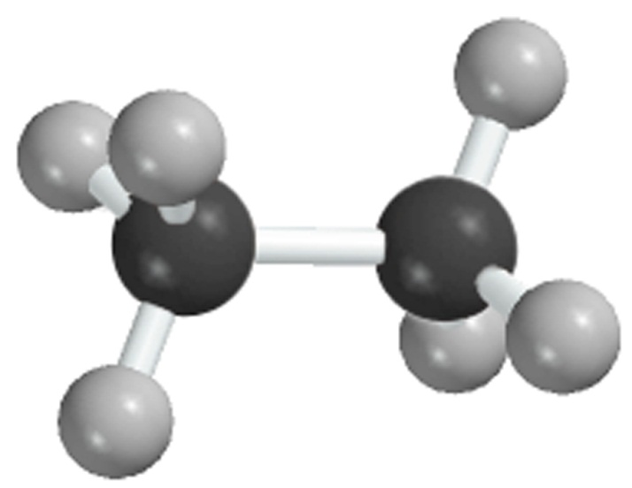
Balancing Chemical Equations
Check to make sure that you have the same number of each type of atom on both sides of the equation.
2C₂H₆ + 7O₂
4CO₂ + 6H₂O
12 H (2 x 6)
12 H (6 x 2)
4 C (2 x 2)
4 C
14 O (7 x 2)
14 O (4 x 2 + 6)
Reactants
Products
4 C
4 C
12 H
12 H
14 O
14 O
3.7

Slide 24
Let’s Balance the Following Equation

Slide 25
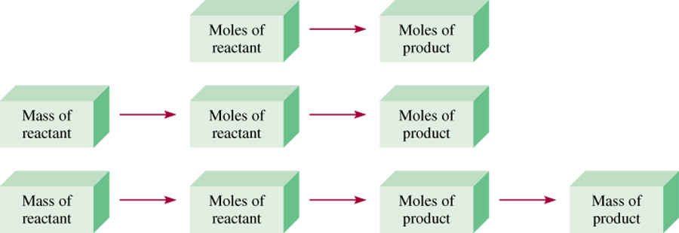
Mass Changes in Chemical Reactions
Write balanced chemical equation
Convert quantities of known substances into moles
Use coefficients in balanced equation to calculate the number of moles of the sought quantity
Convert moles of sought quantity into desired units
3.8

Slide 26
Stoichiometric Ratio
Coefficient B
Coefficient A
Moles B = X Moles A
The stoichiometric ratio is used to determine amounts of compounds
consumed or produced in a balanced chemical reaction

Slide 27
Methanol burns in air according to the equation
2CH₃OH + 3O₂ 2CO₂ + 4H₂O
If 209 g of methanol are used up in the combustion,
what mass of water is produced?
grams CH₃OH
moles CH₃OH
moles H₂O
grams H₂O
molar mass
CH₃OH
coefficients
chemical equation
molar mass
H₂O
1 mol CH₃OH
4 mol H₂O
18.0 g H₂O
209 g CH₃OH
x
x
x
=
32.0 g CH₃OH
2 mol CH₃OH
1 mol H₂O
235 g H₂O
3.8

Slide 28
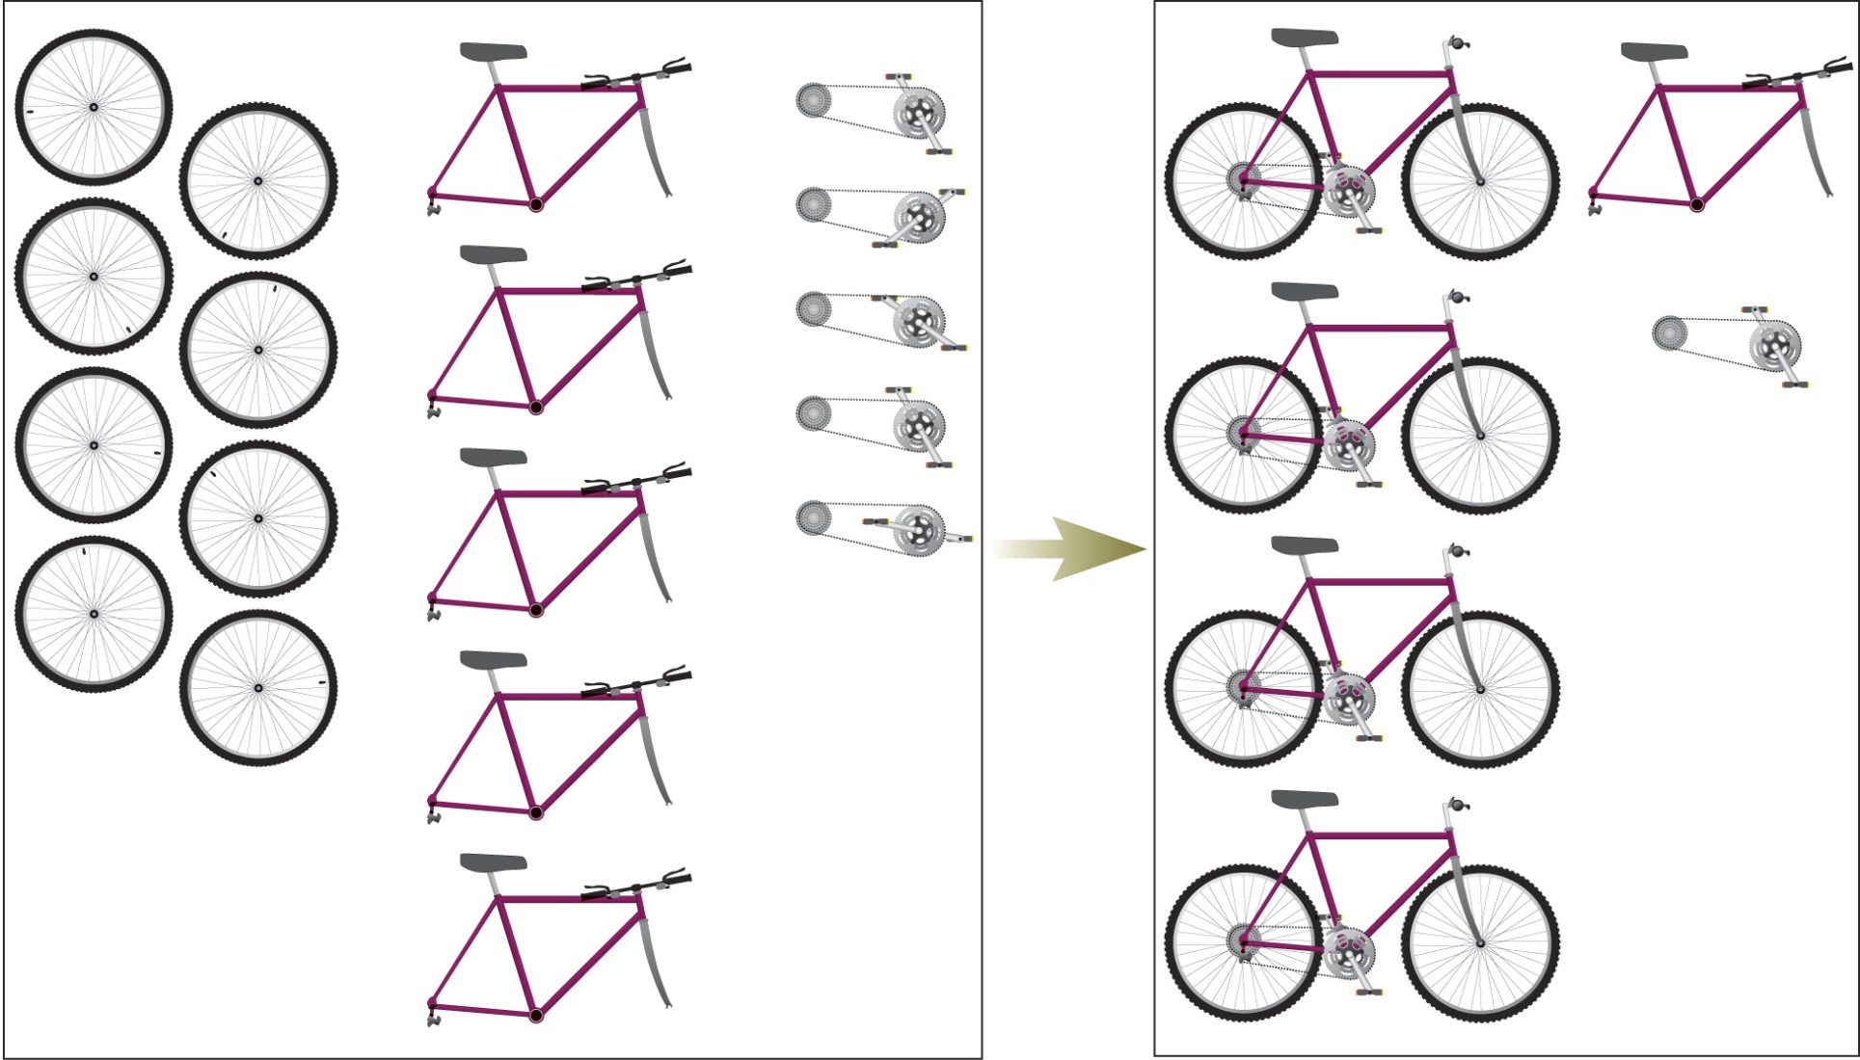
Limiting Reagent
The reactant that is completely consumed by the reaction
The number of bicycles that can be assembled is limited by whichever part
runs out first. In the inventory shown in this figure, wheels are that part.

Slide 29
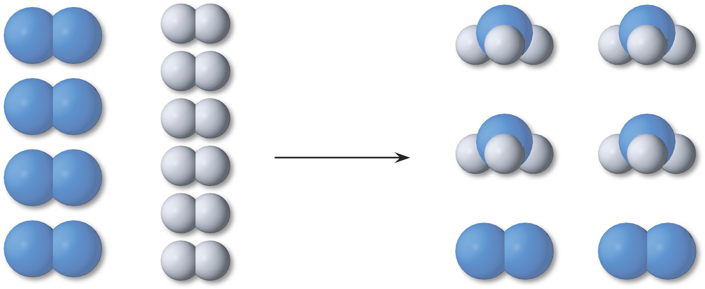
A molecular view of a Limiting reactant situation for the ammonia
Synthesis. To make 4 molecules of NH₃ requires 2 molecules of N₂ and
6 molecules of H₂. If we start with 4 molecules of N₂ and 6 molecules of
H₂, H₂ is the limiting reactant.

Slide 30
Limiting Reagent: It is the reactant whose number of moles divided
By it’s stoichiometric coefficient is the smallest
Example:
Given:
If 1.00 Kg of each of the reactant is allowed to react. How many Kg of
POCl₃ will be formed?
Find the limiting reagent
Find moles of each
Divide by stoichiometric coefficient
The compound with the smallest number of moles is the LR
PCl₃:
Cl₂:
P₄O₁₀:
2. Determine the amount of POCl₃ based on the limiting reagent PCl₃.
Note that the conversions of grams to Kg is not shown.

Slide 31
Theoretical Yield is the amount of product that would
result if all the limiting reagent reacted.
Actual Yield is the amount of product actually obtained
from a reaction.
Actual Yield
% Yield =
x 100
Theoretical Yield
3.10

