Slide 1
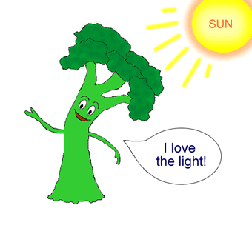
Plant Control Systems
Topic 9.4

Slide 2
Tropisms
Stimuli: environmental factors that induce a response from an organism.
ex: animals
Bee flies toward flowers
Deer runs from predator
Tropism: Plant response to a stimulus.
ex: plants
Stomata opens and closes due to water
Growth, reproduction

Slide 3
Plants can respond to light, gravity and even touch
A tropism is a growth movement whose direction is determined by the direction from which the stimulus strikes the plant.

Slide 4
Positive = the plant, or a part of it, grows in the direction from which the stimulus originates.
Negative = growth away from the stimulus.

Slide 5
Plants respond to:
Light = phototropism
Stems are positively phototropic.
Roots are negatively phototropic.

Slide 6
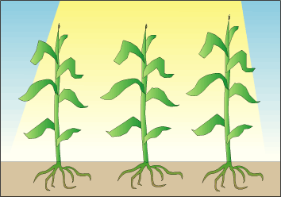
Phototropism

Slide 7
Phototropism

Slide 8
Plants respond to:
Gravity = gravitropism
Stems are negatively gravitropic while
Roots are positively gravitropic.

Slide 9
Gravitropism

Slide 10
Other Tropisms - Hydrotropism

Slide 11
The adaptive value of these tropisms is clear…
Roots growing down and/or away from light are more likely to find the soil, water, and minerals they need.
Stems growing up and toward the light will be able to expose their leaves so that photosynthesis can occur.

Slide 12
Phototropism
The growth of plants towards a light source is called phototropism, which maximizes the amount of light absorbed by the plant’s leaves.
The increased absorption of light yields more photosynthesis, and in turn, further plant growth.
A plant bends towards a light source because its cells respond to the light by growing at different rates.

Slide 13
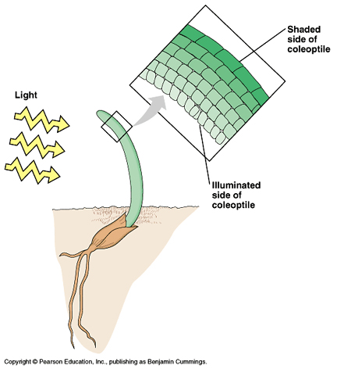
Notice the different sized cells

Slide 14
Through experimentation with oat seedlings, Charles and Francis Darwin concluded that the tip of the seedling detects light.

Slide 15
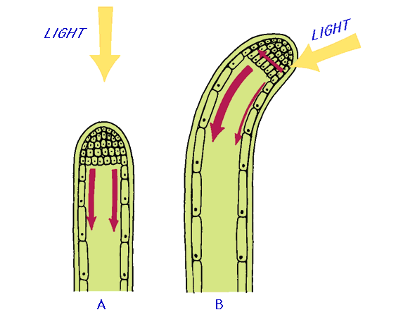

Slide 17
Boysen-Jensen that when a plant is surrounded by rock, it did not respond to the light source.

Slide 19
Auxins: Plant Growth Chemicals
Frits Went hypothesized that there must be a growth chemical produced in the plant tips which stimulates growth.
He called this auxin, meaning “to grow”.
Auxin is a plant hormone that regulates the amount, type, and direction of plant growth.
If light shines on a plant from one side, the auxin moves from the plant tip to the shaded side of the stem.

Slide 20
Auxins Continued:
Active transport moves the auxin through the cells and downward.
The auxin causes cells on the shaded side of the stem to grow longer than the cells on the lighted side.
This causes the stem to curve toward the light.

Slide 21
Notice the different sized cells

Slide 22
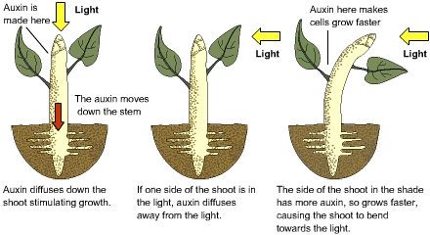
Auxins

Slide 23
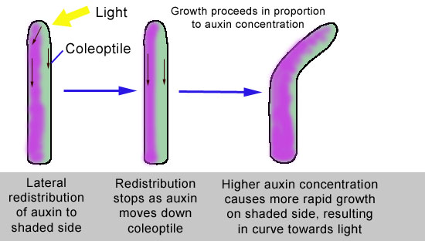
Auxins

Slide 24
Gravitropism
Gravitropism is a plant growth response to another environmental stimulus – the force of gravity.
Gravitropism also involves auxins.
When a plant is placed on its side, more auxin collects in the cells on the stem’s lower side.

Slide 25
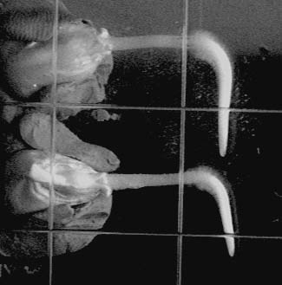
As a result, the cells on the lower side grow longer than those on the upper side.
The growth response causes
the stem to curve upward.
In roots, decreases in
auxin concentration
inhibit root growth.

Slide 26
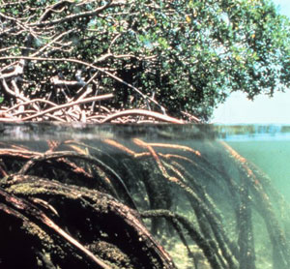
What type of tropism do you see here?
Hydrotropism

Slide 27
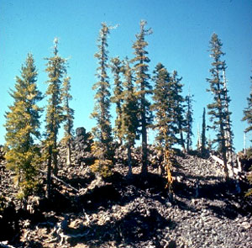
What type of tropism do you see here?
Gravitropism

Slide 28
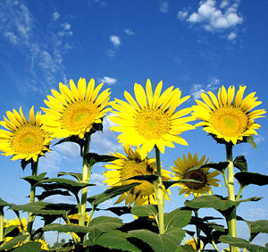
What type of tropism do you see here?
Phototropism

