Slide 1
Water transport in plants
Topic 9.3

Slide 2
Xylem and Stomata

Slide 3
Fill in the Blanks
Nutrition: acquisition of nutrients and water
Transportation systems: transport of nutrients and wastes over short and long distances

Slide 4
Gas Exchange: movement of oxygen and carbon dioxide between organisms and the environment
Waste Removal: removal of wastes from cell processes

Slide 5
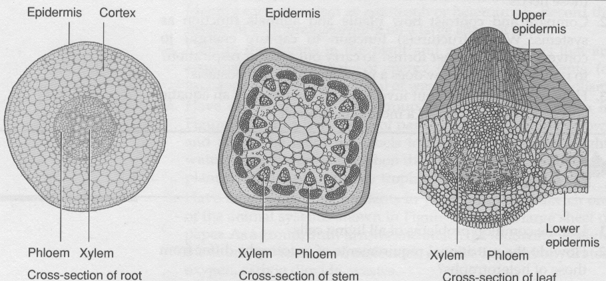

Slide 6
In singled celled organisms such as the spirogyra, transportation of materials around the cell is accomplished by streaming (moving) of the cytoplasm.
Streaming also occurs in the cells of multicellular plants. The transportation of materials (water, minerals, and sugars) within the body of the plant involves two types of vascular tissue, xylem and phloem.
Xylem and phloem are found in the roots, stem, and leaves of many plants. Xylem tissue cells are not living at maturity.

Slide 7
They form long tubes consisting only of the cell walls. These cells are linked and form long tubes called xylem vessels that transport water and inorganic minerals through the plant from the roots to the stem and leaves.
The long hollow cells within xylem vessels are called tracheids or vessel elements. Fluids pass from one tracheid or vessel element to the next within the xylem, to move water through the plant.

Slide 8
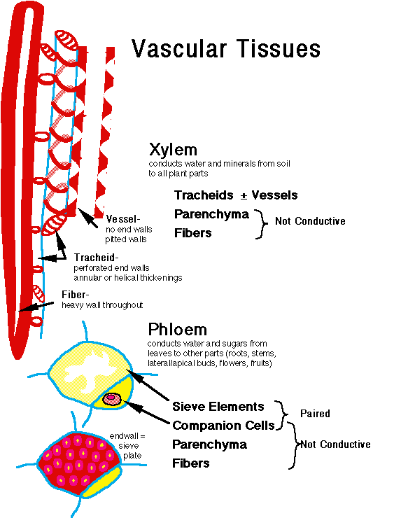

Slide 9
Water uptake in roots
Water enters the cells of the root epidermis by osmosis, where the surface area for absorbing water and dissolved minerals from the soil is increased by hundreds of root hairs. Each tiny root hair is an outgrowth of a single epidermal cell. Water continues to diffuse through the root tissue until it reaches the xylem vessels.

Slide 10
Root cells use facilitated diffusion and active transport to move minerals across their membranes.
Xylem sap is the accumulation of water and minerals in the root xylem, which is carried upward from the roots, through the stem, and into the leaves via xylem vessels

Slide 11
Properties of Water
Water molecules are attracted to each other by cohesion. Cohesion is the attraction between like molecules.
Cohesion explains why a cup of water can be filled just above the brim without spilling.

Slide 13
The attraction of water molecules is due to the fact that water is a polar molecule. One end of the molecule is positive, and other end is negative. This attractive force between water molecules helps keep columns of water from breaking apart or collapsing.

Slide 14
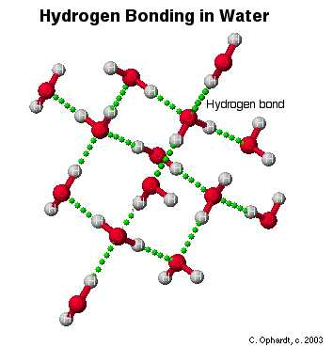
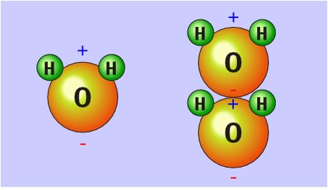

Slide 15
Cohesion helps to explain how water and minerals moves up a plant stem. In the process of evaporation in the leaves, water molecules are pulled away from the upper surface of the columns of water.
When water molecules are pulled from the tops of the columns, an upward pull due to cohesion helps to pull water up in the xylem. As water evaporates and escapes from the leaves in the process of transpiration, more water moves from the soil into the root hairs. Thus a continuous stream of water flows up through the plant.

Slide 16
Adhesion is the tendency of water molecules to stick, or adhere, to certain surfaces.
The clinging of xylem sap to
the xylem walls helps to
prevent the sap from falling
back down to the roots.

Slide 17
Root pressure pushes
Root pressure is the turgor pressure inside the root xylem that pushes the fluid upwards. As root cells bring minerals into the xylem, the mineral concentration increases causing water to diffuse into the root xylem by osmosis.
Root pressure builds up in the xylem vessels and forces fluids upward. Adhesion of the xylem sap to the walls also helps the fluid climb upwards.

Slide 18
Transpiration pulls
In taller plants, transpiration from the leaves generates tension that pulls the xylem sap up. As water vapour exits the leaf tissue, the air within the leaf becomes slightly drier.
This causes water to diffuse out of the leaf cells and into the fluid between the cells. Water, originating from the soil, continues to travel along the xylem vessels toward the leaf cells to replenish this water loss.

Slide 20
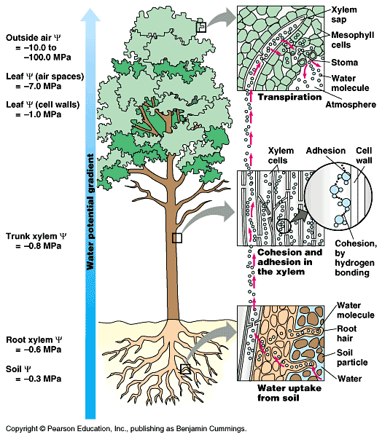

Slide 21
Activity time!
Get into groups of 2 and create a skit that explains all of the following:
Turgor pressure
Root pressure
Transpiration
Cohesion
Adhesion
How xylem cells pull water up the chain

Slide 22
Phloem Tissue:
Unlike xylem cells, phloem cells are living, though some of them lack nuclei. They form phloem vessels with porous cell walls, allowing them to transport organic food material, produced in the leaves during photosynthesis, to all parts of the plant.
Phloem consists of sieve tubes and companion cells arranged end-to-end. Sieve plates are perforated sections that separate sieve tubes and companion cells in phloem vessels.

Slide 23
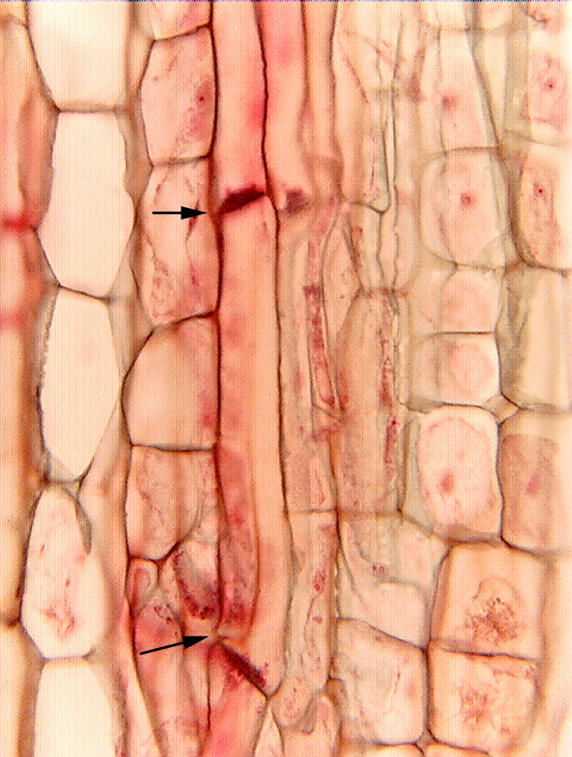
Sieve plates and sieve tubes

Slide 24
Sugar transport in phloem
The sugars produced by the palisade tissue cells and the spongy tissue cells provide energy for the whole plant.
Sugars are transported throughout the plant via phloem vessels, and are then pumped into the leaf phloem by active transport. As the sugar concentration increases in the phloem cells, water follows the sugars by osmosis.

Slide 25
Phloem sap, a mixture of sugars, nutrients, and water, flows down the concentration gradient. The fluid pressure forces the phloem sap through the pores in the phloem cell walls and into the neighbouring cells. As this occurs, nutrients are taken up by various parts of the plant.

Slide 26
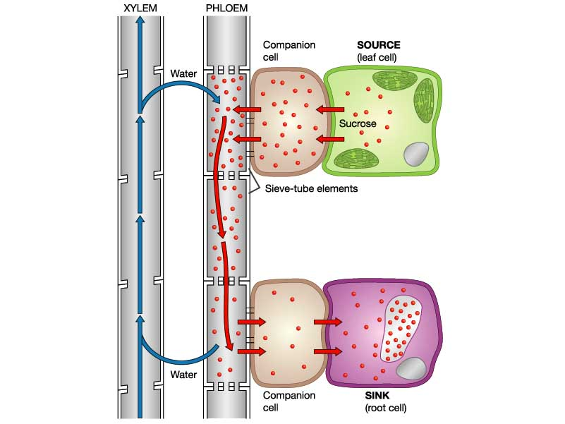

Slide 27
Sugar Transport

