Slide 1
Do Now
Answer the following questions:
How do we know a chemical reaction has occurred?
What makes up all matter?
What makes pure gold different from pure silver?

Slide 2
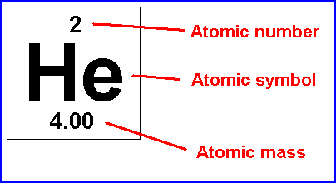
Vocabulary:
mass number
atomic number
nucleon
atomic mass unit (amu)
Symbol Relative Mass Electrical Charge
Proton p⁺ 1 1+
Electron e⁻ 1/1840 1-
Neutron n⁰ 1 0

Slide 3
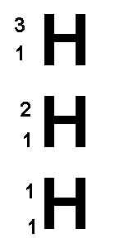
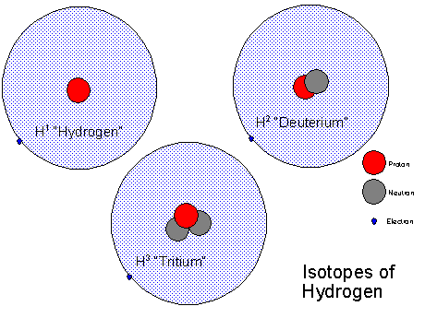
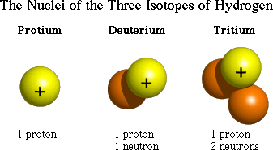
Atomic Symbol Notation:
3 Isotopes of Hydrogen
Mass #
Atomic #
Element Symbol
Example:

Slide 4
Why are there decimal places for “Atomic Molar Mass”?
Why not whole numbers?
The average atomic mass of an element is the weighted average of the masses of its naturally occurring isotopes.
Example:
The isotopes of chlorine are Cl-35 and Cl-37
In nature 75 % of all Cl atoms have a mass of 35 amu (Cl-35)
In nature 25 % of all Cl atoms have a mass of 37 amu (Cl-37)
Therefore, the average atomic mass of Cl is:
(75%) (35 amu) + (25%) (37 amu) = 35.5 amu

Slide 5
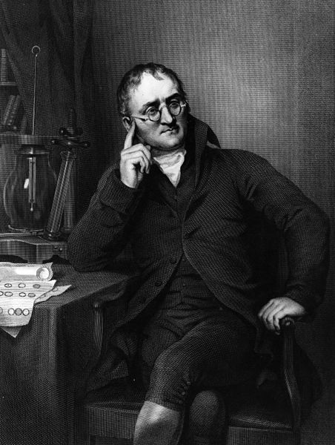
John Dalton
English scientist that developed a theory on the composition of matter based on his observations and experiments.
He stated that each element is composed of a particle called an atom.
He also said that elements that were the same had equal size and mass atoms.
His model theory on matter is sometimes called the “billiard ball model” because he thought atoms were solid spheres.

Slide 6
J. J. Thomson and the Electron

Slide 7
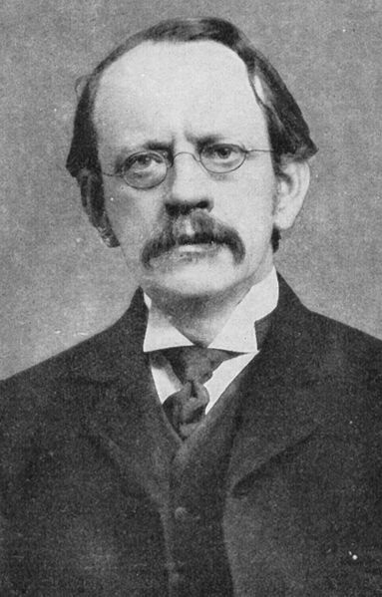
J.J. Thomson
First person to discover a subatomic particle – the electron.
He determined that electrons are negatively charged subatomic particles.
He determined this by showing that a beam of electricity had less mass compared to hydrogen particles.
He thought the electrons were mixed into the atom. His model of the atom is sometimes called the “raisin bun model” or “plum pudding model”

Slide 8
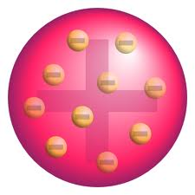
J. J. Thomson Plum Pudding Model
Positive sphere with negative electrons scattered throughout.

Slide 9
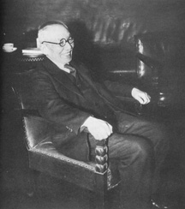
Hantaro Nagaoka
Hantaro Nagaoka refined J. J. Thomson’s model by suggesting that the atom resembled a miniature solar system.
The centre of the atom was positively charged and the electrons orbited around the centre.
Most scientists of his day did not believe in his ideas.

Slide 10
The Discovery of the Atomic Nucleus

Slide 11
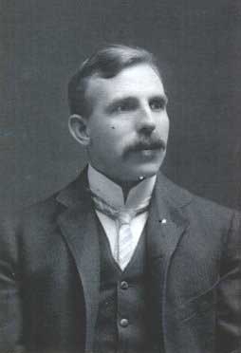
Ernest Rutherford
Experimented with particles by shooting them at each other and different substances.
Through his experiments, he determined a positively charged centre of an atom – the nucleus.
He also calculated the size of the nucleus is about 1/10 000th the size of the whole atom.
Imagine a green pea in a football field.

Slide 12
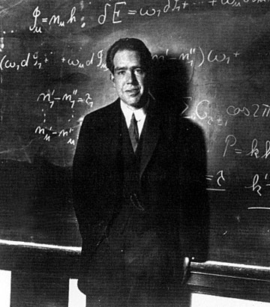
Niels Bohr
Awared the Nobel Prize in 1922 in Physics.
Suggested that electrons do not orbit randomly, they move in a specific circular orbits called electron shells.
He suggested that when electrons move from different electron shells, they either gain or lose energy.

Slide 13
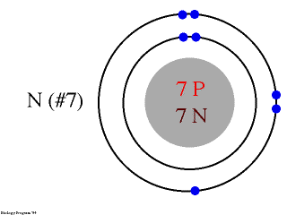
Bohr Model of Nitrogen

Slide 14
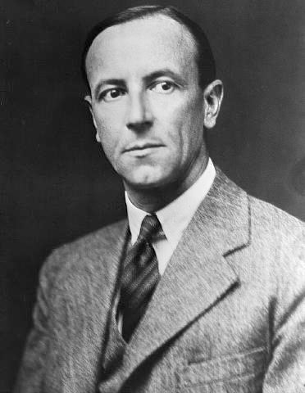
James Chadwick
In 1932 James Chadwick discovered the neutron, which was critical in developing the atomic bomb.
He is credited with discovering the nucleus of an atom to be made up of protons (positively charged subatomic particles) and neutrons (neutrally charged subatomic particles).

Slide 15
Quantum Mechanical Model
1920’s
Werner Heisenberg (Uncertainty Principle)
Louis de Broglie (electron has wave properties)
Erwin Schrodinger (mathematical equations using probability, quantum numbers)
The “electron cloud” model

Slide 16
Quantum Mechanical Model
Electrons are located in specific energy levels.
There is no exact path around the nucleus.
The model estimates the probability of finding an electron in a certain position.
Classifying Electrons
Valence electrons – electrons in the outermost (highest) principal energy level of an atom
Core electrons – inner electrons
Elements with the same valence electron arrangement show very similar chemical behavior.

