Slide 1
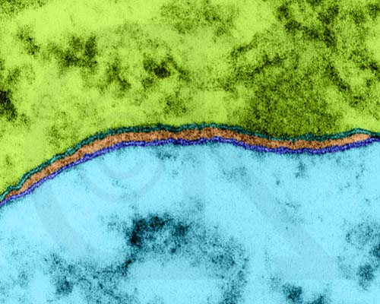
Cell Membrane and Transport

Slide 2
Structure of the Cell Membrane
Composed of phospholipids and proteins
The phospholipids are arranged in two layers and referred to as a phospholipid bilayer
The membrane is made up of phosphate molecules that are hydrophillic (water loving) heads and fat (lipid) molecules that are hydrophobic (water hating) tails
Membrane is fluid, allowing things to drift past one another.

Slide 3
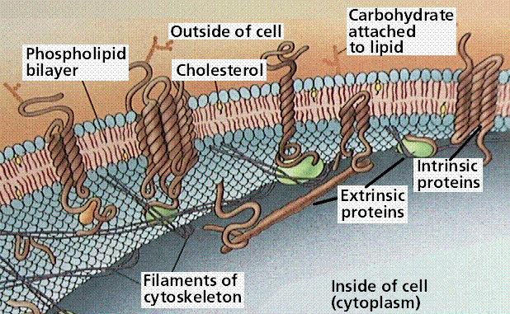
Cell Membrane

Slide 4
Cell Membrane
Function
Retains cell contents
Selective barrier-regulating movement of material into and out of the cell

Slide 5
Since only certain substances are allowed to cross the membrane, movement across cell membrane is therefore called selective transport.
Membranes can be classified in the following ways:
Impermeable: does not let anything pass through the membrane;
Permeable: allows all materials to pass through the membrane;
Semi-permeable: allows some particles to pass through the membrane while excluding other particles

Slide 6
A Phospholipid Molecule
Has two sections:
Phosphate Head – Hydrophillic or “water loving
Lipid Tail – Hydrophobic or “water – hating”
This chemical makeup accounts for the fluidity of the membrane and indicates how these molecules will be arranged in the membrane

Slide 7
Phospholipid Bilayer cont...
Phospholipids arrange themselves into two layers therefore called a PHOSPHOLIPID BILAYER
Lipid tail points inward, away from water
Phosphate heads point outward, towards water
Embedded in the bilayer are various types of proteins

Slide 8
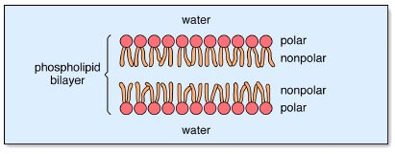
The head of the molecule contains a phosphate group which is “hydrophilic” (water loving)
Lipids are fat molecules with long tails that are “hydrophobic”!! (water hating)
Hydrophobic
Hydrophilic

Slide 9
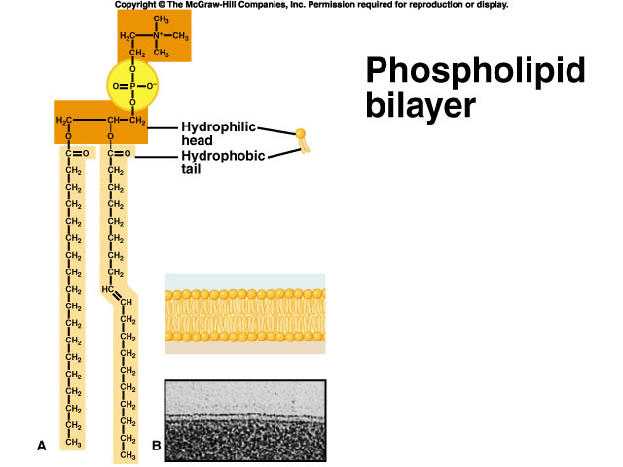

Slide 10
Membrane Proteins
Variety of proteins are imbedded within the two layers of the lipids... These are known as membrane proteins
Proteins serve various functions...

Slide 11
In your notes:
Read the section on Membrane Proteins and answer the question at the bottom of the page.
Next, complete the ASSIGNMENT

Slide 12
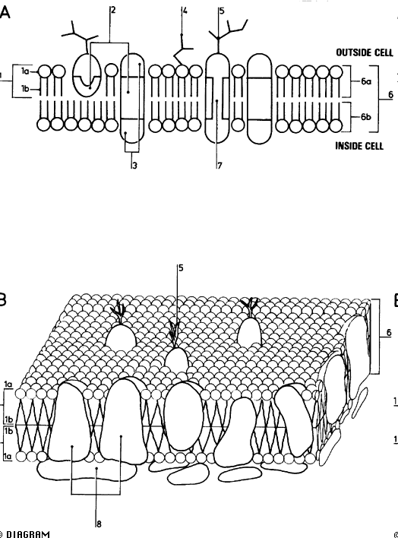
Cell Membrane can you label this?

Slide 13
Plasma Membrane
http://www.youtube.com/watch?v=moPJkCbKjBs&safety_mode=true&persist_safety_mode=1&safe=active

Slide 14
Cell Membrane Labels
A Fluid mosaic model of membrane structure
B Three-dimensional model of membrane structure
1 Phospholipid
1a Hydrophilic head
1b Hydrophobic tail
2 Hydrophobic regions of proteins
3 Hydrophilic regions of proteins
4 Glycolipid
5 Glycoprotein
6 Lipid bilayer
6a External layer
6b Internal layer
7 Hydrophilic channel
8 Membrane proteins

Slide 15
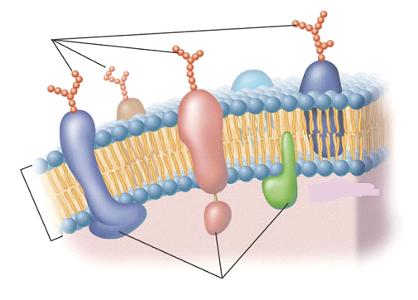

Slide 16
Types of Cell Transport
Substances needed by the cell move into and out of the cell using passive or active transport...
Passive Transport
Active Transport
Cell does not spend energy (ATP)
Cell spends energy

Slide 17
Two types of Passive Transport
Cell does not spend energy (ATP)
1. Diffusion
2. Osmosis

Slide 18
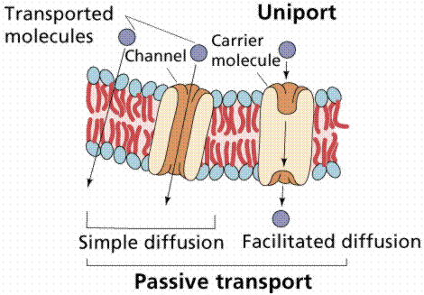
Passive Transport

Slide 19
Passive Transport: Diffusion
The random movement of molecules from an area of higher concentration to an area of lower concentration

Slide 20
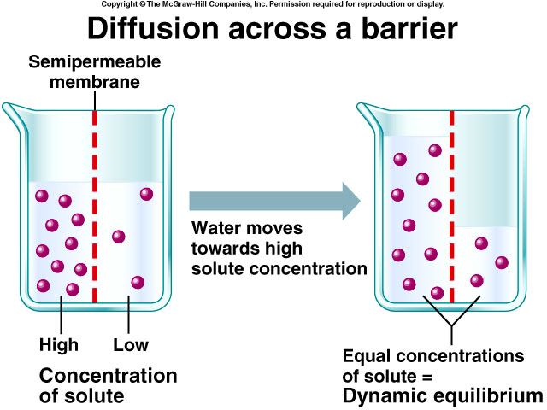
Diffusion across a barrier

Slide 21
Diffusion
Concentration gradient:
The difference in concentration between two areas
Molecules always move from high concentration to low concentration regardless of the amount of other substances mixed with them
Area 1
Area 2

Slide 22
Molecular collisions cause diffusion
Factors affecting the rate of diffusion:
Concentration gradient:
The greater the difference the faster diffusion
Temperature:
The greater the temperature the faster the particles move
Particle size:
The larger the particle the slower the movement

Slide 23
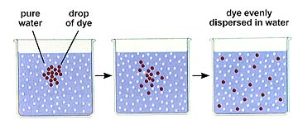
Diffusion
Diffusion continues until equilibrium is reached
Equilibrium is a condition in which the concentration of particles is equally distributed
At this point diffusion stops…..but molecules continue to move equally between areas.

Slide 24
When equilibrium is reached, do particles stop moving???
Equilibrium is when there is an equal concentration of solute on both sides of a membrane.
At this point the molecules move back and forth at an equal rate!!!

Slide 25
Facilitated Diffusion:
The use of transport proteins to aid, assist, or facilitate the diffusion of particles across the cell membrane.
Transport proteins are membrane proteins that help move materials across the membrane. There are 2 types of transport proteins and they are recognized based on their shape, size, and electrical charge:
Carrier Protein: this membrane protein changes shape to allow certain molecules to cross the cell membrane.

Slide 26
Facilitated Diffusion Con’t
Channel Protein: this membrane protein forms tunnel-like pores in the cell membrane, allowing electrically charged ions in and out of the cell.

Slide 27
Passive Transport: Osmosis
Osmosis Definition
The diffusion of water through a selectively permeable membrane from an area of greater concentration of water to an area of lesser concentration.
Selectively permeable
The ability of a cell’s membrane to allow certain substance to pass through more readily than others

Slide 28
Terms Related to Osmosis:
Solute:
molecules that are dissolved in a solvent
Solvent:
substance that dissolves a solute – in the case of osmosis – water!!
Dialysis membrane:
a membrane that allow the movement of molecules based on size

Slide 29
Solutions cont...
The cytoplasm of a cell never contains water alone and neither does a cell’s exterior (i.e. the extracellular fluid)
Cells contain other molecules dissolved in the water called solutes
There are three types of solutions:
Hypotonic
Hypertonic
Isotonic

Slide 30
Hypertonic Solutions
Greater solute concentration outside of cell than inside
(Solutes = molecules dissolved in water)
Solutes outside of cell draw water out
Cell will shrink
Movement of Water
Cell Shrinks

Slide 31
Hypotonic Solutions:
Lower solute concentration outside of cell
Water molecules move from area of high concentration to area of low concentration
Cell will expand.
Movement of Water

Slide 32
Isotonic solutions
Ideal situation
Concentration of molecules is the same inside and outside of the cell
Results in balanced water movement
Water in = Water out

Slide 33
Osmosis & Turgor Pressure:
Osmosis is what keeps plant cells plump and full of water so that plants don’t look wilted
Water pressure inside a plant cell pushes against the rigid cell wall causing turgor pressure
The walls of plant cells are able to withstand a great deal of turgor pressure (function of the vacuole)
This is not the case with animal cells... If an animal cell gets too much water by osmosis, it will burst!!!

Slide 34
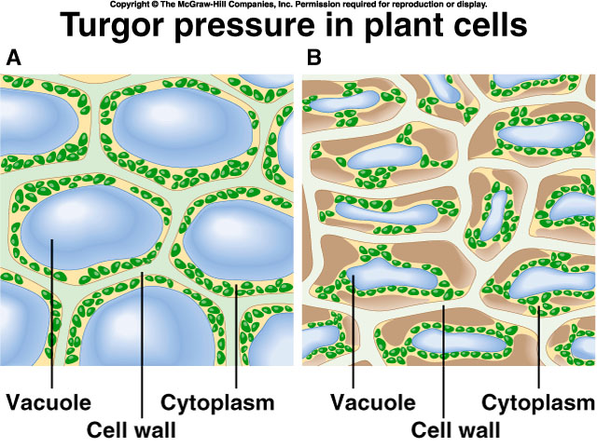
Turgor Pressure in Plant Cells

Slide 35
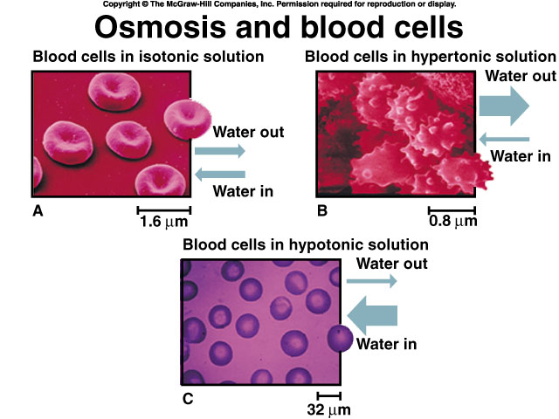
Osmosis and Blood Cells

Slide 36
Below are three diagrams that show three identical cells in three separate beakers of solution. The relative concentration of water and solute molecules is given for the cell in each beaker. Complete the diagrams by drawing the molecules of water and solution required to make the external fluid in each beaker hypertonic, isotonic, or hypotonic, as indicated. Use arrows to show the direction of water flow, with a thicker arrow indicating more molecules moving in one direction.

Slide 37
Assignment
Answer the three questions in your notes

Slide 38
Active Transport Cell uses ATP (Energy) From LOW to HIGH concentration
Transport Protein
Cell Membrane
Exocytosis
Endocytosis
Phagocytosis
Pinocytosis

Slide 39
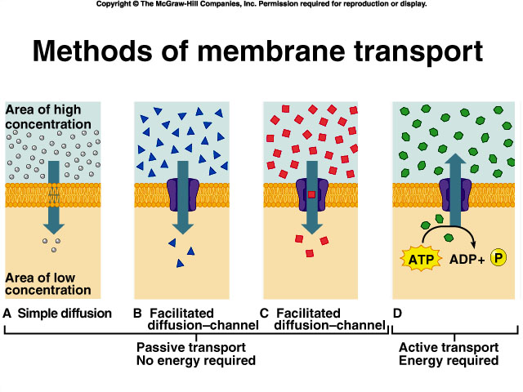
Methods of Membrane Transport
Active Transport

Slide 40
Active Transport
Always requires the cell membrane
Energy (ATP) is used
Substance are often transported from an area of low concentration to an area of high concentration against their concentration gradients
High Concentration
Low Concentration

Slide 41
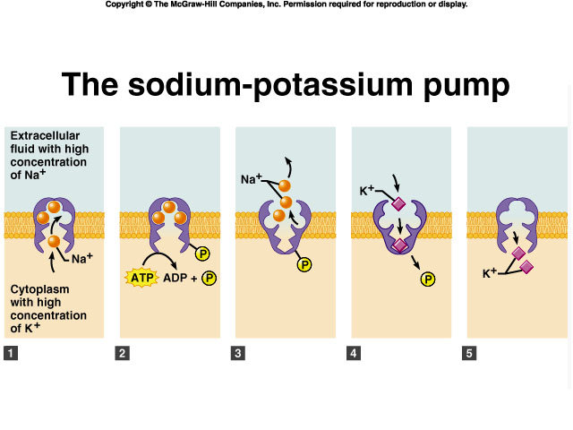
An example of active transport in the human body (nerve cells)

Slide 42
Active Transport Cell uses ATP
Transport Protein
Cell Membrane
Exocytosis
Endocytosis
Phagocytosis
Pinocytosis

Slide 43
Movement of Particles in & out of Cells: Exocytosis/Endocytosis
Both require ATP energy!!!
Endocytosis
Exocytosis

Slide 44
Endocytosis
Cells engulf large particles by extending their cytoplasm around the particle
The ingested particle is trapped within a pouch or vacuole, inside the cytoplasm
Enzymes from the lysosomes are often used to digest the large particle absorbed

Slide 45
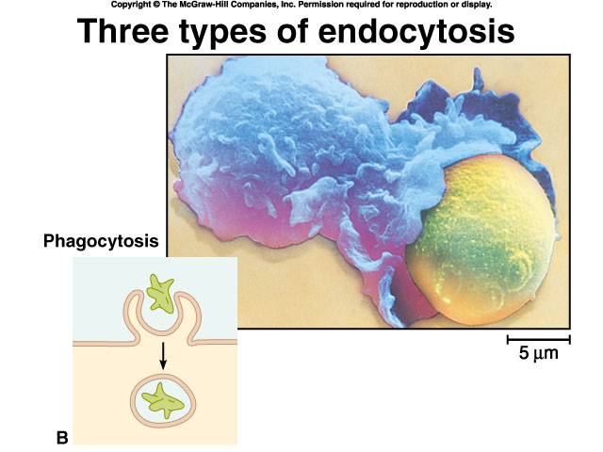
White blood cell
devouring a yeast cell!!!
Phagocytosis (cell eating): cells engulf solid particles or other cells

Slide 46
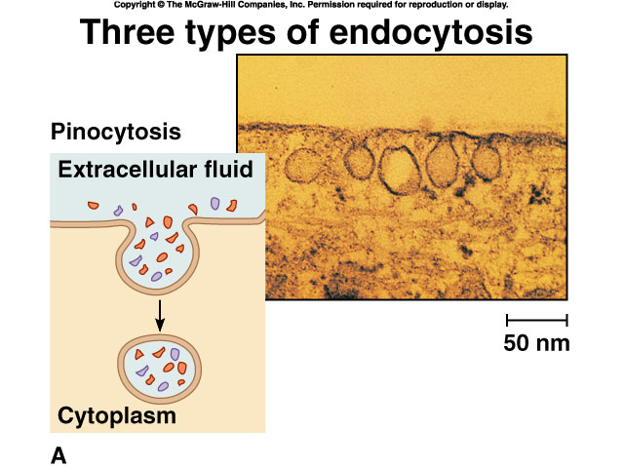
Three types of Endocytosis
Pinocytosis: cells absorb liquid droplets

Slide 47
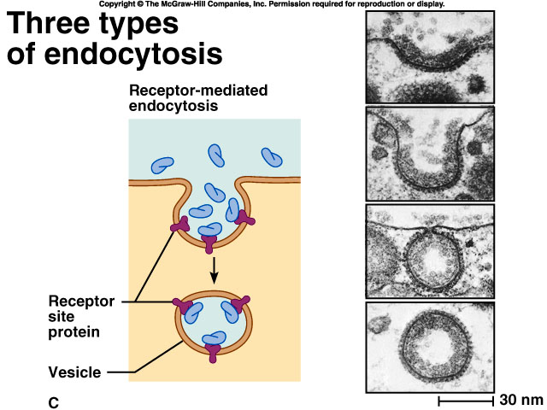
Molecules attach
to receptor
sites which aid
in the transport
across the cell
membrane

Slide 48
Exocytosis
Large molecules within the cell are transported to the external environment

Slide 49
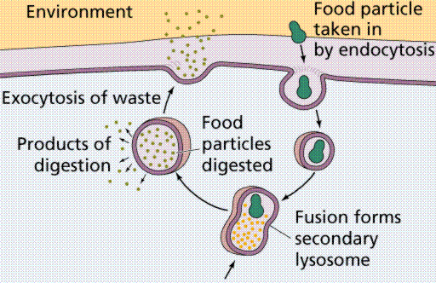
Exocytosis
Waste materials are often released by exocytosis

Slide 50
Exocytosis
Useful materials, like transmitter chemicals from nerve cells are also released
Small vesicles break off the Golgi apparatus and move towards the cell membrane
The vesicles fuse with the cell membrane and the fluids are released

Slide 51
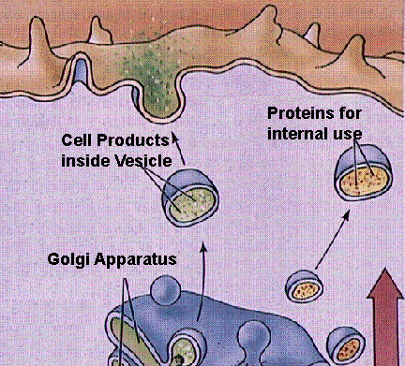
Exocytosis of Secretions

Slide 52
Membranes at Work
Reverse Osmosis: is a process used to purify water in which water is filtered through an artificial membrane containing very fine pores.

Slide 53
Kidney Dialysis: blood is pumped through tubing made from a synthetic, semi-permeable membrane (dialysis tubing) that is immersed in a salt solution with a concentration similar to blood, but which does not contain wastes. The pores in the tubing allow small dissolved waste molecules to diffuse out of the blood while retaining large proteins and blood cells.

Slide 54
Membranes at Work
Transdermal Patch: a semi-permeable skin patch which allows medications to diffuse out of the patch and in to the body at a slow, constant rate. Another method to deliver medication is by artificial vesicles called liposomes

Slide 55
Characteristics | Simple Diffusion | Endocytosis | Active transport
Active or Passive?
External energy?
Direction?
Size
Examples
Where?

