Slide 1
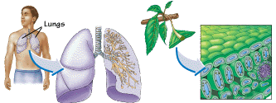
9.2 → Gas Exchange in Plants

Slide 2
Something in the Air
The air we breathe is a mixture of oxygen, carbon dioxide, water vapour, nitrogen, and other gases.
Both plants and animals consume oxygen and produce carbon dioxide and water during cellular respiration.
Plants, however, are capable of photosynthesis in which they consume the carbon dioxide and water and produce oxygen and glucose

Slide 3
Cellular Respiration:
C₆H₁₂O_{6(s)} + 6O_{2(g)} → 6CO_{2(g)} + 6H₂O_{(l)} + energy

Slide 4
Photosynthesis:
6CO_{2(g)} + 6H₂O_{(l)} + light energy → C₆H₁₂O_{6(s)} + 6O_{2(g)}
In fact, when plants undergo photosynthesis, they consume much more carbon dioxide than they release during cellular respiration.

Slide 5
Leaves and Lenticels
The most important gas-exchange organ is the leaf.
Carbon dioxide enters the leaf through the stomata where gases can diffuse through the cell membrane of the spongy tissue cells, and once dissolved, used by chloroplasts in photosynthesis.

Slide 6
Leaves and Lenticels
Oxygen then diffuses out of the spongy tissue cells and is released from the leaf through the stomata.
Water, which enters the leaf through the network of xylem, also exits through the stomata as vapor.
Woody plants have lenticels, which are lens-shaped openings perforating the bark and allowing gas exchange between the bark and the living cells.

Slide 7
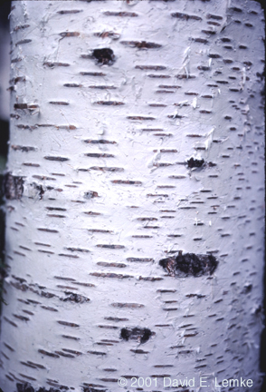
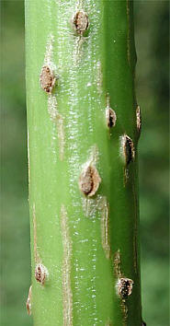
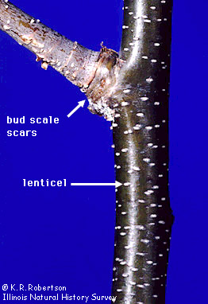

Slide 8
Gas Exchange is Tied to Water Loss
As air diffuses out of the stomata, some of the water is lost.
The evaporation of water from leaves is called transpiration.
To keep plant cells from drying out, guard cells can change their shape to cause the stomata to open/close.

Slide 9
Gas Exchange is Tied to Water Loss
When the stomata are open, carbon dioxide can enter the leaf and oxygen and water vapour exit. Therefore, high rates of photosynthesis are possible when the stomata are open.
When the stomata are closed, gas exchange and water exchange are reduced. Less photosynthesis occurs when the stomata are closed.

Slide 10
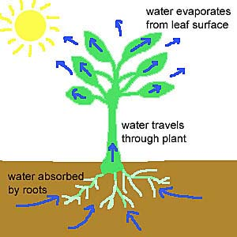
Transpiration Continued
A tree can lose 200L of water per day!
Must regulate water loss by closing guard cells
If guard cells are closed no gas can enter and photosynthesis is reduced.

Slide 11
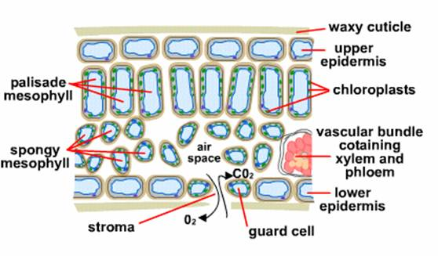

Slide 12
Water moves into the guard cells by osmosis, and as it does so, the pressure inside the cells increases and causes the cells to swell.
This high pressure, called turgor pressure, causes the cells to remain rigid.

Slide 13
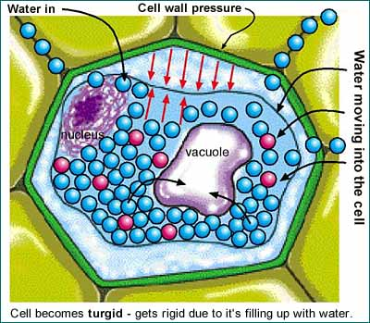
Turgor Pressure

Slide 14
As transpiration occurs, water exits the cells and they deflate.
In most plants, the stomata are open during the day and close at night.

Slide 15
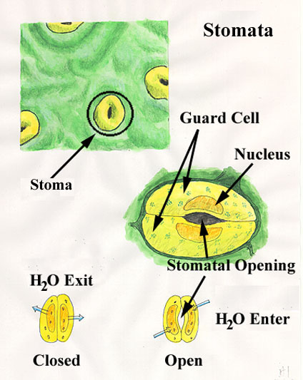

Slide 16
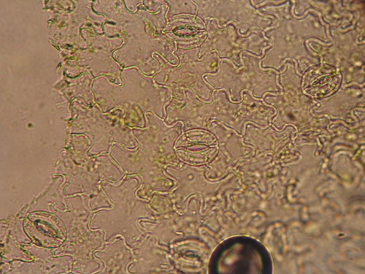
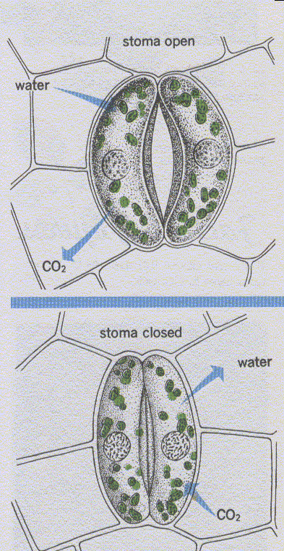
Stoma opening and closing
Stomata on lettuce epidermis

Slide 17
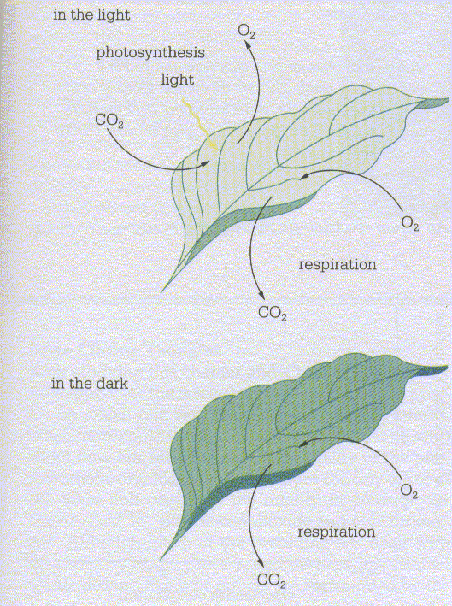
Movement of gases

Slide 18
Factors that affect the rate of transpiration include:
Light
Temperature
Humidity

